Slide 1
Toward an Unified Metadata Model for ‘Research Objects’
Matthew Brush
Oregon Health and Science University
November 3, 2015
Notes:
Work we have started recently toward defining a unified . . .

Slide 2



About Me
Bench Scientist Turned Data Scientist
Cancer Biology -> BioInformatics -> Biomedical Ontology
OHSU Ontology Development Group (ODG) Development and application of ontologies to facilitate discovery and use of research data and resources
eagle-i resource discovery platform
eagle-i.net
Resource Identification Initiative
force11.org/node/4824
Monarch Initiative
monarchinitiative.org
Notes:
First a bit about me.
I am a bench scientist turned Data scientist
After 12 years as a bench scientist I transitioned into informatics in 2009, and landed in the ontology world in 2011 with the OHSU ODG
Our group develops and applies ontologies to facilitate the discovery and use of research data and resources
Our projects span various aspects of biomedical research:
eagle-i provides a set of ontology-driven tools for researchers to discover and share the research resources.
The RII is an effort to support the unique identification of research resources in the literature and track their use.
Monarch Initiative is a effort toward large scale integration of human and model organism genotype-phenotype data using ontologies, and tools build to navigate and apply this data for research into human health and disease.
------------
(All of these projects driven under the hood by ontologies and other semantic technologies)

Slide 3
Project Overview
Three month contract between Elsevier and OHSU
Full time pre-doctoral intern (Olga Giraldo)
Part time faculty mentors (Matthew Brush, Melissa Haendel)
Goal: Develop a high-level model of experimental research concepts to serve as a framework for describing ‘research objects’
Notes:
The work I will present today resulted from a three month contract
Contract funded a full time . . .
Goal was deceivingly simple:
Discussion today will review our process and progress toward this goal.
------------------
share some outcomes, and discuss future work/recommendations,
and tour the deliverables that we created for suture reference
------------
universal conceptual and metadata model

Slide 4
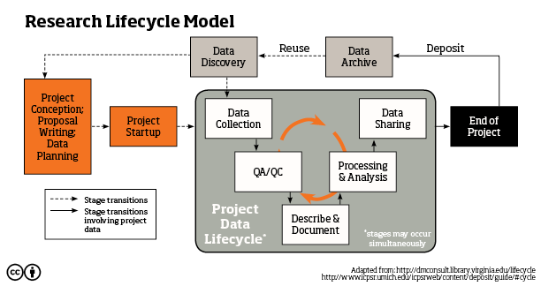
‘Research objects’ are information artifacts that are utilized or produced in the research lifecycle
funding proposals
curated
shared/archived
data sets
protocols
experimental
records
primary
datasets
data management
plans
publications
presentations
secondary
datasets
code / workflows
progress
reports
Project
project repositories
(github, OSF)
Metadata about research objects is becoming increasingly important in today’s data intensive research paradigm
Notes:
‘Research object’ is a very vague term that is used in different ways in the research community. Here we mean information . . .
This depiction of the research cycle shows types of research resources relevant at each stage (in red)
As a project is conceived funding proposals and DMPs are generated.
Protocols are created as work is initiated to starts to collect data.
As experiments are performed, experimental records and primary datasets are generated, and then iterative cycles of analysis, documentation, and QA generate things like secondary . . .
As a project matures, more formal objects might be created and tracked in project repositories, and ultimately if successful, a publication is generated.
Nowadays this is often accompanied by the archiving of curated datasets in public repositories for discovery, evaluation, and re-use – ultimately to drive the next round of research proposals.
Metadata about research objects is becoming increasingly important in todays data intensive paradigm – to ensure rigor and reproducibility through each turn of this cycle.
Datasets have been the poster child for the Research Object movement, as standards and efforts are most mature around datasets compared to other research objects, so this will be the focus of work I present today.
But the issues and models around data can and should apply to all of these research objects in some way.
----------------
In blue are some of the material research objects that are generated and used in research that are equally important to track and describe.
(each of these artifacts requires some level of metadata to ensure that knowledge isn’t lost through each turn of this cycle – in the context of both a single lab, and the global research enterprise as a whole)

Slide 5







Applications for this Work
Facilitate Internal Efficiencies
Conceptual alignment and communication
Uniform collection of metadata across Elsevier systems
Support Community Integration
Metadata integration for search across external systems and research domains
Inform community metadata standards for research objects
DATA SEARCH
Notes:
So Elsevier's interest in research objects stems from its belief that there is great value in building RDM systems to support management and sharing and re-use of these things across the research lifecycle.
This is evidenced by its impressive suite of established and developing RDM tools.
The research object here is obviously complex, and
The goal of the work we were contracted to do is to begin the legwork needed to establish a foundation for developing and enhancing the RDM systems in a coordinated and community-minded way.
My take on this is that there are two levels or stages of application for the domain and metadata models we are building (and Anita can chime in here as well as I am essentially distilling her thoughts here)
The first is to facilitate internal efficiencies – by supporting conceptual alignment and communication within and between teams, and facilitating more uniform collection of metadata across Elsevier systems
A second is to support integration of metadata.
An immediate application here is Integrated Data Search Tool Elsevier is building which requires metadata integration across diverse systems and domains.
And longer term to inform the development of community metadata standards that could drive more coordinated efforts in the future.
----------------
The first is to facilitate . . . by supporting within and across units in the Elsevier organization
The second is to support broader efforts requiring alignment and integration across the research community
support metadata integration . . . (relevant for systems such as Mendeley Data Repository and Integrated Data Search Platform
inform development of community metadata standards

Slide 6
Today’s Topics
Research Object Landscape Analysis
Project Deliverables
Generic Metadata Recommendations
Reference Domain Model
Experimental Metadata Model (EMM)
Next Steps and Recommendations
Notes:
So for today we will first explore the research object landscape to learn from existing efforts in this area.
These lessons informed the deliverables that were defined for this project, which include a set of generic . . .
We will review these, and end with a summary of next steps and recommendations resulting from this work

Slide 7
I. Landscape Analysis
A. Initiatives
How connected and aligned are community efforts?
What partners might we engage in our future work?
B. Standards (vocabularies, ontologies, data models and formats)
How diverse and aligned are existing models?
Where are gaps in coverage?
What might be re-used or inform our modeling efforts?
C. Systems (data repositories, data journals)
What metadata is collected by schemas?
What standards are used to structure this metadata?
Notes:
So as I mentioned we began our work with an old fashioned landscape analysis to get a sense of the initiatives, standards, and systems related to research objects, again focusing in particular on datasets.
We wanted to know . . . .
With respect to existing standards, we wanted to understand . . .
And finally we wanted to see what metadata is collected in existing systems for sharing datasets, and what standards are used to structure this metadata
(NO JUMP TO SPREADSHEET YET)
------------------------
So we know of course that there is a lot of work in the area of RD management, sharing, and standards and scholarly communication
Our first step was to explore this landscape and learn from it.
Performed a broad review of existing initiatives, standards, and systems
We wanted to understand how aligned . . .
We hoped the lessons we learned would help us define requirements for our work and define a set of deliverables
Broad review of relevant communities, initiatives, standards, ontological models, and data systems (link)
What can we learn from existing work to inform our efforts?
What gaps and needs are outstanding (to meet our efforts)
What challenges will we encounter and partners might we engage in our integration efforts?

Slide 8
Initiatives
Motivated community initiatives share goals and ideals but not resources
FORCE11, FAIRport, RDA, CASRAI
NIH BD2K Initiatives (Data Discovery Index)
Can learn from principles, successes, and failures
Engage key partners early to lay groundwork for future community integration efforts
Notes:
So what lessons did we learn:
Lots of interest in these problems – many motivated community initiatives share goals and ideals around facilitating data sharing, evaluation, and re-use
Many grass-roots efforts that operate largely independently, but with significant cross-talk and overlap in membership.
These include . . . – (as with many such efforts) a lot of talk but not a lot of action due to limited bandwidth and resources
In addition, the NIH recently launched a more top-down effort in its BD2K initiative to address many of the same issues.
One project under this initiative that is particularly relevant for today is the Data Discovery Index . The DDI pitched as a comprehensive catalog and suite of and tools for registering and discovering datasets across the biomedical landscape. We will touch on metadata work for the DDI later.
So the key take homes here are that there is much we can learn from the principles, successes, and shortcomings of these efforts
And that it is important to engage key partners early to lay groundwork for any community integration efforts we aspire to in the future.
-------------------
This is a broad and comprehensive approach to develop tools, standards, and training for biomedical research data.
Seeks to tap and partner with existing communities, and push their progress in defining requirements and standards toward development of usable tools and systems (e.g. a global data discovery index, and tools for semantic metadata creation). Too early to tell how this will work.
Important to engage . . .more on this in future directions

Slide 9
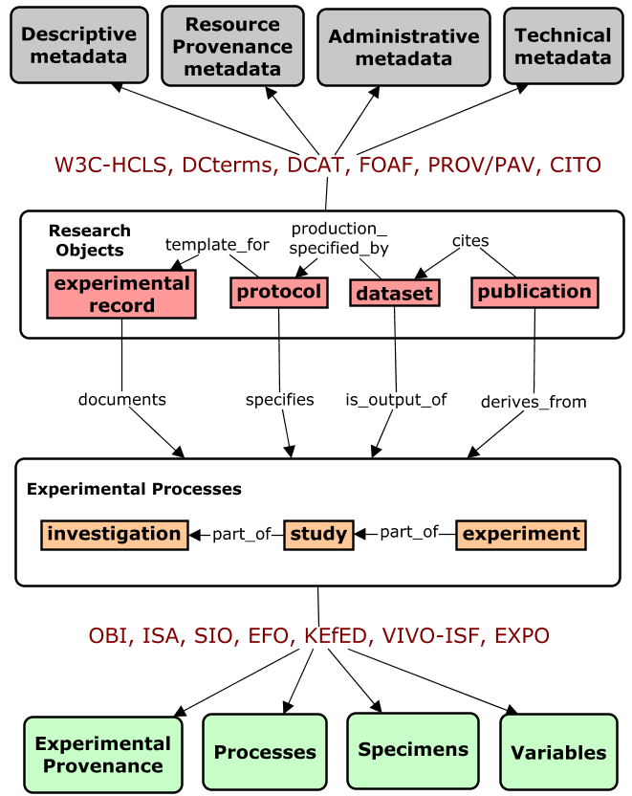
Standards
1. Generic Metadata
Title, Contributors, Identifiers, Creation/Modification Dates, Version, Access Info, File size, File Format
Directly describes datasets
Many mature and widely used standards exist, reasonably aligned
Two Levels of
Metadata Standards
for Research Objects
2. Experimental Metadata
Indirectly describes datasets by capturing experimental provenance
Existing standards not scoped or packaged for efficient metadata collection and search, and lack shared foundation for interoperability
Notes:
We next explored nearly 50 standard related to research objects - including metadata schema, formats, and ontologies.
The diversity and complexity here was overwhelming, but made a bit more palatable if we distinguish two levels of metadata standards in this area:
Generic metadata standards directly describe datasets and other research objects – capturing attributes such as their title, . . .
This is contrasted with experimental metadata standards that capture information about the experiments that produce datasets rather than the datasets themselves
We found that for generic metadata, there are many mature standards that are reasonably aligned and widely used to collect real metadata.
Some prominent standards are shown here in red.
Work here has reached the point where the W3C HCLS – has made efforts to merge and define ‘best of breed’ standard that unifies elements from 20 different standards into a coherent and comprehensive model for describing datasets.
By contrast, existing standards for experimental metadata are less mature and not yet widely used.
Some examples are listed here that we will explore more closely in a bit.
We found that most ontologies in this area are not scoped of packaged for practical use in collecting metadata.
We also noted a lack of interoperability between these efforts – each defining their own terms and conceptual model of the domain.
So this is a key challenge that we will face in efforts to integrate research object metadata, and one our work here begins to address.
-------------------------

Slide 10

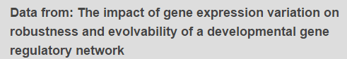
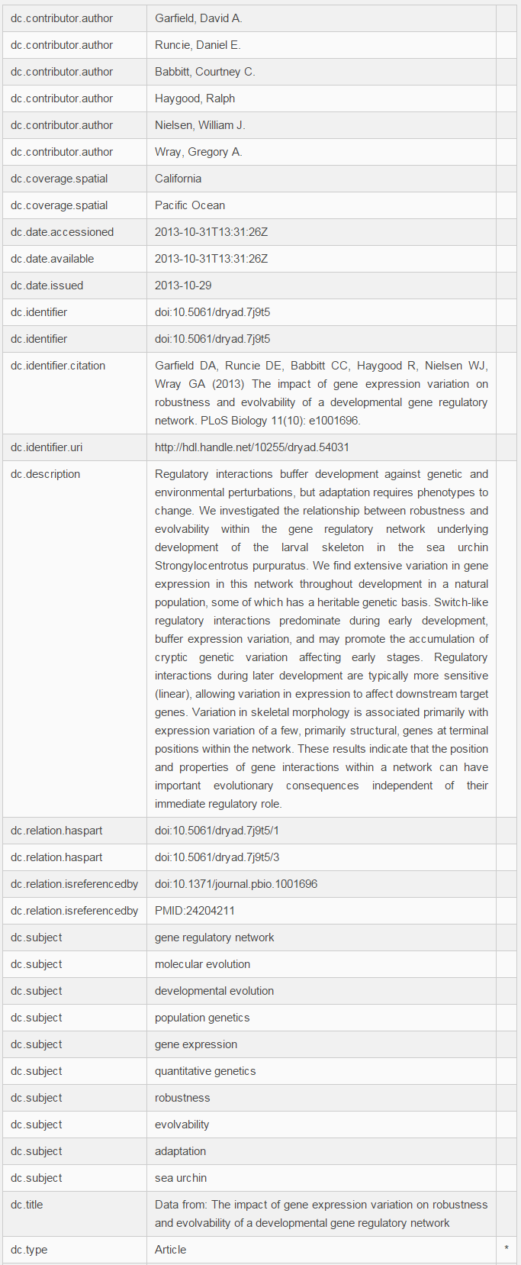
Systems
1. Generic Data Repositories
Dryad, FigShare, Dataverse
Use internal schema, alignment with standards varies
Structured metadata collected primarily for generic attributes of the dataset
Minimal structured metadata about experiments that produced data (keywords)
http://datadryad.org/resource/doi:10.5061/dryad.7j9t5
Notes:
Finally, looked a three different types of systems that house research datasets.
The first was generic data repositories such as
We found that these systems use different internal schema, and alignment with standards varies (DC most common – many schema developed as DC application profiles)
Structured metadata in these systems in collected primarily about generic attributes of the dataset, with minimal structured data describing features of the experiment or research domain
Here is an example from Dryad . . . adopts dc elements, primarily about the dataset, only information about the experiment and domain is free text in an abstract, and subject keywords.
-----------------------------------
Initial focus was on large scale generic data repositories, given Elsevier use cases around developing a similar repository and data search tools across such systems
Most striking observation was that structured . . .
one reason is that standards and models of experimental domain are not suited for data entry and discovery use case
-------------
Focus on systems cataloging and describing datasets submitted by researchers (as opposed to curated databases that aggregated data around specific entities, e.g. MGI,

Slide 11


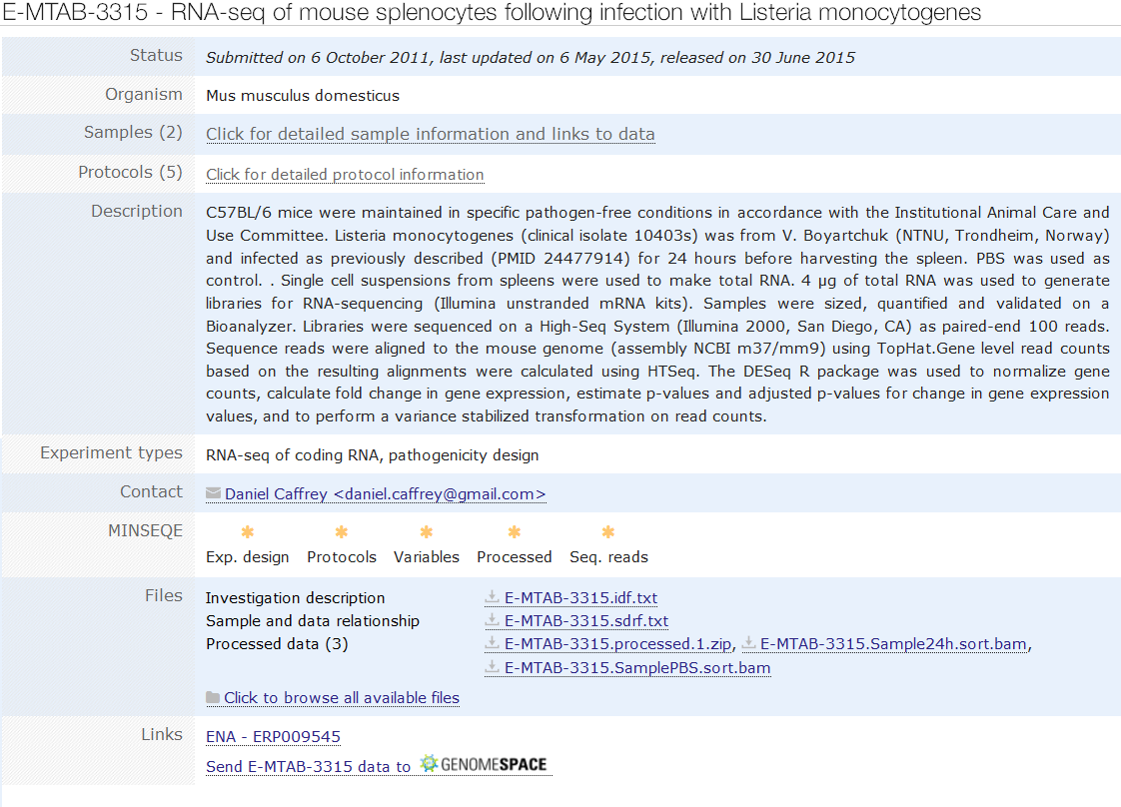
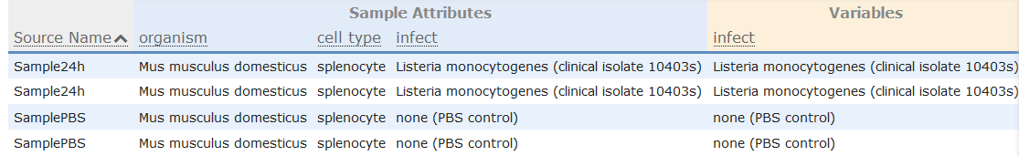
Systems
2. Domain-Specific Repositories
e.g. ArrayExpress, GEO
Methods
Experimental
Variables
Specimen
Characteristics
http://www.ebi.ac.uk/arrayexpress/experiments/E-MTAB-3315/
Notes:
We next explored a handful of domain-specific repositories such as Array-Express and the Gene Expression Omnibus in the domain of gene expression data
These data-type specific repositories do better with respect to experimental metadata, as their more focused content makes this information easier to collect.
Here is an example of what experimental metadata captured in the Array Express repository
We see descriptions of methods, specimen characteristics, and experimental variables – and these are structured using the EFO ontology.
Other gene expression repositories like the GEO capture even richer data in structured way, but they largely fail to adopt community standards in a way that would support data integration.
-------------------------------------
(review metadata)
slightly better in that it captures . . . , so it can support some experimental queries such as . . .
but does not formally capture context needed to answer more precise queries such as
(note that publised as RDF accessible from EBI SPARWL endpoint
--
“Developed in relative isolation, many of them are created on dedicated technology platforms not optimized for integration with external search and
indexing services.”
Again, these boutique repositories that focus on specific types of experimental data are able to capture such details because of how constrained their scope is
The challenge remains is developing a generalizable framework for capturing experimental metadata across disciplines and datatypes
-----------------------------
these repos can often capture more specific and granular metadata because of the uniformity of the data they hold.
This repo focuses less on the generic metadata about the dataset such as . . . (which we saw captured in the dryad example), and more on metadata about the experiment that produced the data, such as . . .
This is useful for understanding how the experiment that produced the data was performed
and also useful for discovery of these datasets based on experimental attributes such as . . . . We will come back to this idea later when we dive deeper into metadata for research artifacts.

Slide 12




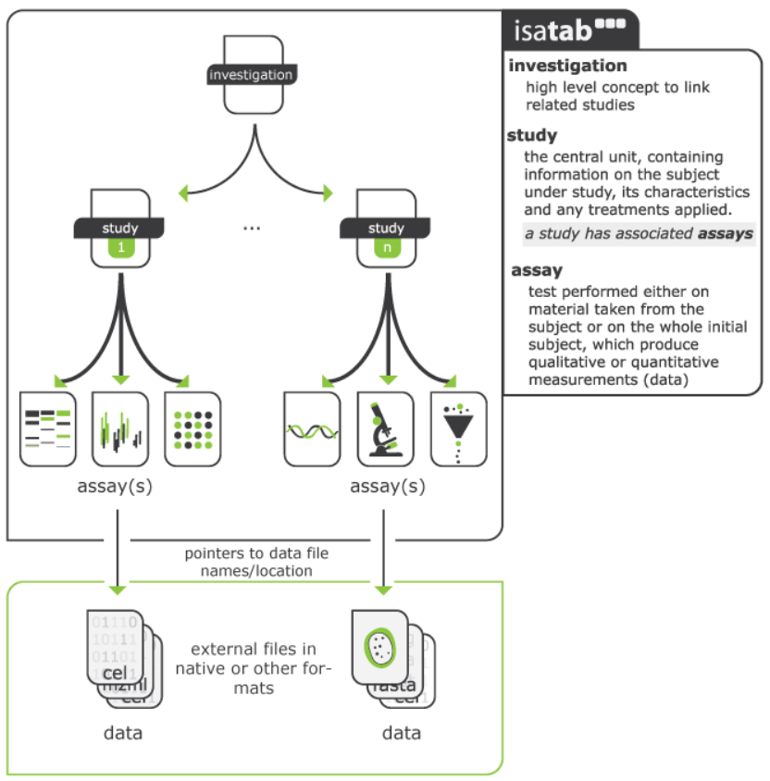
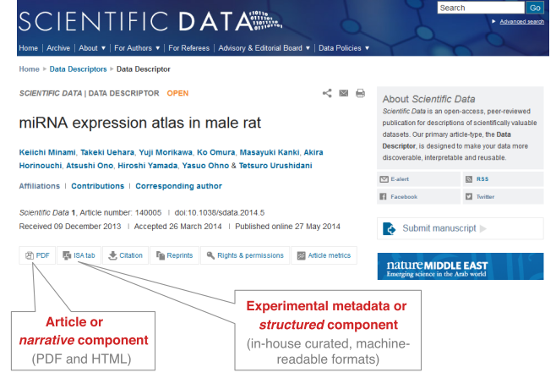
Systems
3. Data Journals
Nature Scientific Data
DataOne
Biodiversity Data Journal
Susanna Assunta Sansone, http://www.slideshare.net/SusannaSansone/fair-data-and-npg-scientific-data-riken-yokohama-25-june-2014/23
Notes:
Finally, we looked at the rise of data journals that provide rich descriptions of datasets in the form of publications.
NSD is most prominent example. This is a peer reviewed publication where articles, called ’Data Descriptors’ odescribe high-value and high-quality data sets.
But not a repository - recommend actual data stored in open community repositories (generic such as dryad or figshare, or boutique such as GEO).
These provide a narrative description that is accompanied by a structured metadata package that uses the ISA format.
The ISA model supports collection of rich experimental metadata at the level of the investigation, study, and assay, and is scoped to support data re-use and reproducibility.
It is used in a handful of data repositories and journals but not widespread.
Nice place to use ISA model because authors willing to put in the work for a publication - but this level of curation impractical for other systems to implement.
-------------
where there is impetus an incentive to spend the time creating very detailed and rigorous metadata. Because here they use cases to support interpretation and reproducibility, not simply data discovery. But this isn't the case for most other data sets and repositories, and that the case for our efforts which are focused on the discovery.
Mention that they use the ISA model to provide a structured metadata set in addition to the data descriptor narrative. Captures rich and granular metadata for purpose of interpretation and reproducibility
not a repository – recommend actual data stored in open community repositories (generic such as dryad or figshare, or boutique such as GEO)
higher standard as these are publications – Nature Scientific Data
More rigorous and comprehensive metadata collected, including experimental metadata
Nature adopted leading community standard for describing biomedical research data – ISA

Slide 13
II. Lessons Inform Project Deliverables
A diverse and informative body of work already exists in this area that can inform our efforts.
D1. Landscape Analysis : structured evaluation of initiatives, standards, and systems (link)
A strong foundation of standards and practices generic metadata collection exists
D2. Generic Metadata Recommendations: identify core elements and propose standards to adopt (link)
Key challenge lies in defining standards for experimental metadata that can support its collection and integration
D3. Reference Model of Experimental Concepts (link)
D4. Experimental Metadata Model Straw Man (link)
Notes:
So with our landscape analysis we learned many important lessons that helped us to define specific deliverables for our remaining work. toward a unified metadata model for describing research objects.
We learned that a diverse and informative body of work already exists in this area that can inform our efforts.
Deliverable 1 is a structured review of this landscape.
We learned that there is a pretty strong foundation of standards and practices around generic metadata collection.
And Deliverable 2 is a set of recommendations identifying core elements and standards to adopt here
We learned that the real challenge lies in defining standards around experimental metadata that can support its collection and integration . And that a shared conceptual framework is needed to support this goal.
Toward this end, Deliverable 3 is a Reference model that defines core concepts in the domain relevant.
Deliverable 4 builds on this reference model to define a more formal experimental metadata model that can support data collection
For the rest of my time today I want to give a tour of these deliverables and outcomes.

Slide 14
D1. Landscape Analysis
Structured evaluation of initiatives, standards, and systems (link)
High level summary of all relevant efforts
Deeper evaluation of models and standards
Overview of all groups working on “Research Objects”
Notes:
. . . in the interest of time I will just provide a link to this document for now.

Slide 15
D2. Generic Metadata Recommendations
Proposes set of core metadata elements and standards (link)
Informed largely by W3C-HCLS Data Description Standard
Can guide early iterations of metadata schema for developing systems
And inform subsequent community integration efforts
Notes:
The next deliverable is a set of recommendations for standards to align with for generic metadata collection.
I should not that this work was informed largely by W3C-HCLS Data Description Standard, which has already done most of the work here. This standard provides what is essentially a ‘best of breed’ model that that unifies elements from 20 different standards into a coherent and comprehensive schema for describing datasets
This work can guide . . . and
Wont present this either right now in the interest of time, but happy to discuss during Q&A.
------------
an effort our group was involved in with same charge – led by Michel Dumontier who is now at Stanford / CEDAR group

Slide 16
D3. Reference Model of Core Experimental Concepts
Concept Glossary (link)
Experiment | Data Set | Research Study | Technique | Investigator | Research Organization | Research Facility | Study Design | Study Group | Experimental Variable | Control Variable | Independent Variable | Dependent Variable | Reagent | Instrument | Research Specimen | Source Specimen | Precursor Specimen | Evaluated Specimen | Environment
Conceptual Models
Taxonomic hierarchy organizes these concepts according to their ontological type (material, process, attribute, information) (link)
Ontology graph illustrates relationships between concepts (link)
Notes:
Our third deliverable was a reference model that identified and clearly defined core experimental concepts in the domain.
We identified ~20 concepts deemed most relevant for an experimental metadata model, and assembled them into a glossary that gave them clear ‘ontological’ definitions.
Again, goal here is to provide a foundation for understanding and communication, and that could inform subsequent development of models and standards.
The bolded terms are those that turned out to be central players in our metadata model, which we will discuss shortly.
At present this glossary if part of the larger google doc documenting our efforts (go to document) – will take a quick peek now.
Concepts are described with a label, alt term, detailed definition, and discussion of significance of the term in the domain and for our metadata model.
Also provide view of these concepts in a hierarchy that organizes them according to their ontological type
And in a concept graph that illustrates relationships between concepts from a more or less realist perspective.
Wont go into details of this hairball because as it turns out, reality isn’t the greatest way to efficiently structure metadata – defining the best abstractions and shortcuts to make is the fun in defining the metadata we will review next.
----------------------------
Goal is to agree on the meeting at relationships between key concepts underlying experimental research, and use this as a basis for a shared understanding, clear and efficient discourse in communication, and a starting point and guiding set of principles for any integration efforts.
Need highlighted by observation that existing standards lack a shared foundation for discourse and interoperability – that identifies key concepts, rigorously defines and distinguishes them, and defines relationships that hold between them in context of a scientific experiment.
Now this is exactly the goal of domain reference ontology's such as OBi and Sio. And these models certainly informed our work. But to be practically useful a more focused set of concepts that are defined in the context of a specific use case, such as data said discovery and integration, is ultimately what will be useful in practice. And what can inform schema for collecting experimental metadata for these purposes.
what we aimed for was really a version of OBI scoped for a specific use cases (experimental metadata for discovery of research objects)
------------------
Start by just defining some core concepts - so I actually like this as a place to start distilling the large amount of information we have waded through and knowledge we have gained. What I have done is identified ~20 most important concepts relevant for an experimental metadata model that addresses our use cases and requirements.
I documented these in a google doc for now in the form of a glossary that . . .
And also two hierarchical artifacts: an ontological subsumption hierarchy that . . . and a hierarchical metadata schema
------------
Later this schema is translated into an ontological model (or at least a cmap specification of what one would look like)

Slide 17
D4. Experimental Metadata Model
Deliverables
Metadata Model Proposals: Organize core domain concepts as a schema to support efficient metadata creation and search (link)
Exemplar Metadata Records - Illustrates features of the metadata model using real data (link)
Requirements Analysis
Scoped by identifying priority use cases
Driven be competency questions (link)
Informed by evaluation of existing models
Notes:
So a more formal experimental metadata model that could be used in practice to collect and search for experimental metadata was final and most important output of this work.
Deliverables included a first iteration straw man proposal for the metadata model, and a set of exemplar metadata records illustrating is application.
As with any modeling work we do, we began by performing requirements analysis on three levels.
The models would be scoped by identifying priority use cases
Their content and structure would be driven by CQs and informed by an evaluation of existing models

Slide 18
Priority Use Cases
Search/Discovery: meet minimal criteria for discovery based on experimental attributes and relationships
Data Entry: intuitive and efficient collection of structured metadata with minimal curation burden
Interoperability: enable alignment with existing metadata schema
Notes:
Wide range of possible use cases for describing datasets . . . models are defined and optimized differently depending on the use case and project requirements.
The aim is always for a model with minimal complexity required to meet use cases.
Listed here are the three use cases we prioritized for our work, based on needs we identified in our landscape analysis and project-related requirements from Elsevier.
For a search and discovery use case – must meet the minimal criteria to support discovery based on experimental attributes and relationships.
. . . This depends on queries users want to ask to discover data.
For data entry use case, we need to support efficient collection of structured metadata with minimal curation burden – so this is really about making the model as simple and intuitive as possible
For interoperability use case, we want to enable alignment with existing metadata standards and schema – this is of course important for application towards data integration.
--------------
Claims Analysis: structured to trace dependencies between samples, assays, variables, and outcomes , to support evaluation of claims and evidence supporting them
Reproducibility: captures sufficient detail about experimental participants and execution to support reproduction of results
Not an exhaustive list, but runs gamut from very simple requirements to much more complex and granular ones

Slide 19
Competency Questions
"Find datasets linked to publications from the Lin Lab"
"Find gene expression datasets produced using RNAseq technologies"
“Find imaging datasets from pathogen-exposed mice "
"Find datasets produced using Fugene reagent in cells derived from human colon"
"Find datasets investigating stroke in elderly smokers”
"Find datasets exploring effect of kinase knockdown on antigen expression in transformed vs normal primary cell lines”
Notes:
So for our primary use case of search and discovery, it is critical to collect CQs to inform scope and design of the model. These are essentially a rich and diverse set of queries different users might ask of our system.
CQs help to specify entities to represent and the relationships between that will most efficiently answer user queries.
We collected a large set of CQs based on in house domain expertise, and looking at query logs from different systems.
Shown here are some examples that were useful in informing our modeling work.
Will give you a minute to read a few . . .
We were not surprised to find a strong preference for discovery based on experimental attributes. This of course highlights the need for a metadata model to capture this information in a clear and consistent way.
-------------------

Slide 20
Evaluation of Existing Standards
OBI (Ontology for Biomedical Investigations) Broad and rich, but focus in on biomedicine, and not suited or being used as a metadata model/schema
ISA (Investigation-Study-Assay) Schema A schema for metadata collection that is widely used, but model is too complex, under-constrained, and not scoped for our use case
KEfED (Knowledge Engineering from Experimental Design) A high-level schema with appealing level of simplicity/abstraction, but lacks ontological underpinning, and structured for claims analysis use cases.
EBI (European Bioinformatics Institute) RDF Platform Supports data collection and scoped for discovery use case, narrowly defined for specific datatypes and domains
Existing models do not serve our needs ...
Notes:
Finally, we also looked to existing standards to provide requirements for our work. As noted this is particularly important for our interoperability use case.
We focused on these four standards in the domain of biomedical investigations (OBI, Isa, KEfED, and EBI) . . . will make a long story short here and just say that while they may serve their communities and use cases well enough, none are really scoped to meet our needs. (perspective, complexity, use cases, granularity)
But while these models don’t directly serve our needs, . . .
------
Alt Narrative:
We focused on these four standards in the domain of biomedical investigations, and a careful review revealed that while they may serve their communities well enough, none are really scoped to meet our needs.
OBI: Broad and rich, but focus in on biomedicine, and not suited or being used as a metadata model/schema (too complex, tied to realist view). So we can use this to inform our work, and aim to align with it, but it is not directly applicable as a schema.
ISA: we touched on earlier as a format that is built specifically for metadata, but model is too complex for our needs, in part because it is scoped more for re-use and reproducibility use cases than discovery and data entry.
KEfED Framework: A high-level framework with an appealing level of simplicity and abstraction. But it is structured for claims analysis use cases, and receives limited use in the community. (More of a framework than a formal semantic schema).
EBI: provides semantic models to represent data in their systems, including ArrayExpress. These models are scoped for data collection and discovery, but narrowly defined for specific datatypes and domains (e.g. microarray in Array Express)
So, while existing models . . .
------------------------------
Isa and EBI – specimen centric model
KeFED and OBI – process centric models
Variable centric model most efficinet for metadata creation and search
- no have to create instances for each specimen/sample in a study, and describe each process applied to them
just present a summary level view of all TYPES of processes and reagents and specimens used, organized around the experimental variables that describe how they participated in the study
top down approach to defining requirements.
Upshot is existing models do not serve our needs . . . none support level of integration with existing ontologies to adequately constrain data entry

Slide 21
. . . But They Still Have Much to Offer
Converge on central relationship between techniques, specimens, and variables
Techniques: material preparation, assays, analysis
Specimens: material input(s) processed and ultimately examined in an experiment
Experimental Variables: entities measured, varied, or held constant in an experiment
Dependent variable: specifies entity and attribute measured in an assay
Independent variables: specifies parameters intentionally varied to test affect on dependent variable
Controlled variables: parameters not varied across study groups
Notes:
. . .they still have much to offer.
A key trend that emerged from reviewing these efforts focused us on the central relationship between . . . that was common across these models. (You'll recognize some of these terms from our concept glossary)
Techniques are research processes or methods applied in preparation, measurement, and data analysis.
Specimens are material input(s) processed and ultimately examined as the subject of an experiment.
Experimental Variables are factors intentionally varied or measured
Dependent variable: specifies entity and attribute measured in an assay (e.g. gene expression level in a microarray, or action potential amplitude in a patch clamping assay)
Independent variables: specifies parameters intentionally varied to test affect on dependent variable (e.g. chemicals applied to cells test impact on gene expression)
Controlled variables: parameters not varied across groups (reagents, instruments applied to all study groups, characteristics of specimens intentionally held constant)
I highlight these concepts because their interplay is the basic for the metadata model we defined and will review shortly.

Slide 22
Driving Principles and Requirements
Generic but Extensible: accommodate diverse research disciplines while supporting extensions for specific domains and use cases
Pragmatic for Data Entry and Discovery Use case: balances efficiency of data entry with complexity needed for query resolution
Captures experimental roles of specimens, techniques, and variables and the relationships between them
Supports Interoperability and Re-Use
Support integration of data across existing repositories
Use community CVs/ontologies to standardize data entry
Facilitate data that is amenable for third party use (LOD)
Notes:
So we emerged from our requirements analysis with the following high-level principles in mind.
We needed a model that is Generic but Extensible, in that it can accommodate diverse research disciplines while supporting extensions for specific domains and use cases
We needed a model that is pragmatic for Data Entry and Discovery Use cases, in that it balances efficiency of data entry with complexity needed for query resolution
And we needed a model that Supports Interoperability and Re-Use, in that it could Support integration of data across existing repositories, and would use community CVs/ontologies to standardize data entry
------------------------
Important to be explicit about the role different entities play in the experiment in concise a way as possible (not only capture what participates in an experiment, as many repos do with keywords, but the how

Slide 23
Modeling an Exemplar Experiment
Hypothesis: Differential stress-response pathways are activated in brains of normal vs memory-impaired mice.
Treatment: exposure of a mouse model of Alzheimer’s Disease to DMSO (control) or arsenite (oxidative stressor)
Specimen Collection #1: collection of astrocytes from hippocampi of mice displaying normal vs impaired memory (in water maze tests)
Specimen Collection #2: isolation of mRNA using TRIzol reagent to obtain mRNA samples
Assay: expression microarray analysis using an Illumina HT-12 array to identify patterns in level of gene expression
Controlled Variables Independent Variables Dependent Variables
Notes:
So the clearest way to demonstrate the model itself is to show how it captures metadata for a real experiment.
So here is our canned example. It is relatively simple and meant to illustrate core features and utility of the model.
This experiment explores the hypothesis that differential . . .
It begins with a chemical treatment: exposure of a mouse model . . .
Astrocytes are then collected from the hippocampi of mice displaying either normal or impaired memory function in a water maze test.
mRNA is then isolated from these astrocytes, and used as input in a microarray assay to test gene expression patterns.
I have highlighted concepts that represent control, independent, and dependent variables – because these concepts play a central role in our model. You may find requires a new way of looking at an experiment – to think first of the type of variable things represent rather than the experimental role they play as a reagent, specimen, or instrument, which is also captured but secondarily.
For example, astrocyte and hippocampus are control variables because these are features common to ALL study groups in the experiment.
DMSO and arsenite on the other hand are independent variables that help define separate study groups in the experiment. And of course the level of gene expression is the measured, dependent variable.
------------
Highlighted are the terms referencing instances of some of the core elements in our metadata model (namely techniques, specimens, . . . ). These represent important keywords users will query on to find datasets/ROs . . . so a key goal of our model is to capture this in as concise and standardized a way as possible.

Slide 24
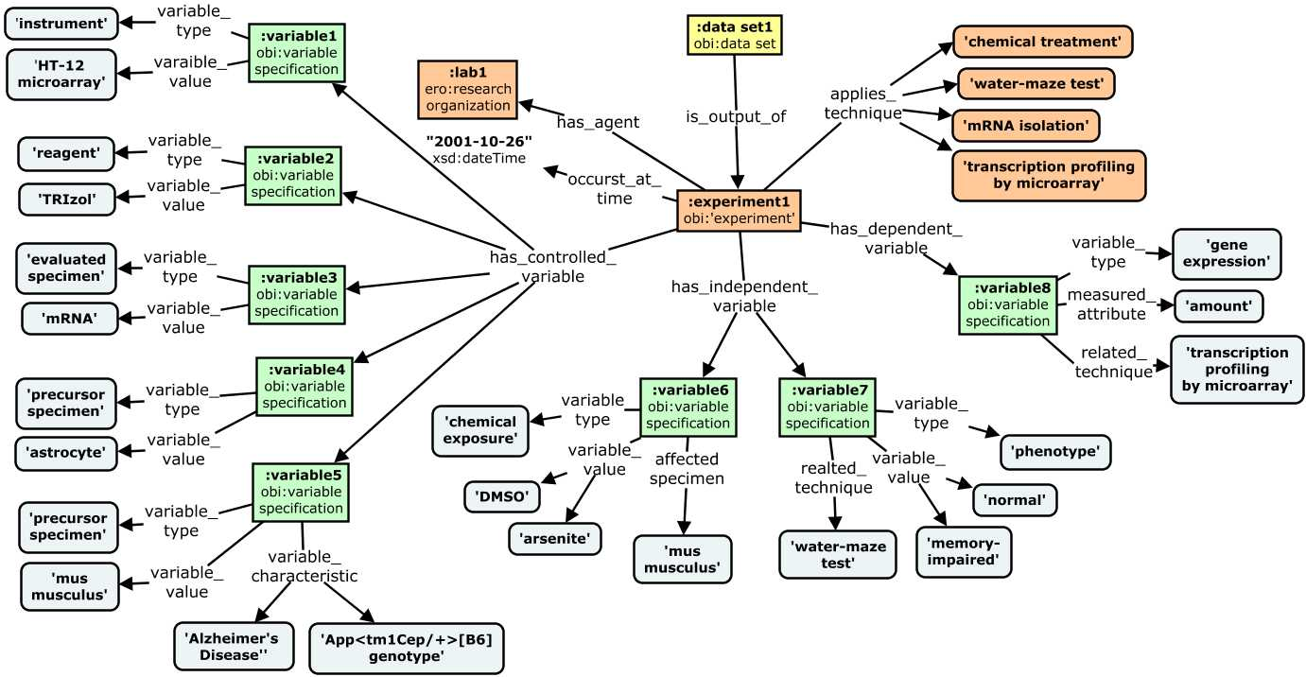
Modeling an Exemplar Experiment
Notes:
This concept map shows how our model represents metadata about this experiment.
Different color for each ‘level’ in the model - try to limit the number of levels for ease of data collection and queries.
Experiment in orange is focal point. At this level we collect provenance metadata about the experiment rather than the dataset such as who performed it and when. We also link it to specific techniques applied in the experiment.
The next level in green is where we clearly see the focus of the model around experimental variables. Terms from CVs and ontologies that represent key features of the experiment are organized around these variable specification nodes. We believe that this approach provides just the right context for supporting discovery use cases and competency questions. (we will explore this in a minute)

Slide 25
Modeling an Exemplar Experiment
Notes:
Looking at the dependent variable first - the entity and attribute measured in an assay
We see that this specification describes entity and attribute measured in an assay (namely the level or amount of gene expression) as well as the optional indication of the specific technique used for measurement.

Slide 26
Modeling an Exemplar Experiment
Notes:
Next we can look at the independent variables - again this represents parameters intentionally varied to test affect on dependent variable
There are two independent variable specifications in this experiment, one is a chemical exposure that specifies dmso and arsenite to different study groups, and the other is a phenotype variable that specifies normal vs memory impaired.
Additional properties can be used to record things like the type of specimen affected, and the specific technique used to apply or determine the variable.

Slide 27
Modeling an Exemplar Experiment
Notes:
Finally, controlled variable are parameters not varied across study groups
These specifications follow similar pattern. They allow description of reagents and devices that are not varied in the experiment, as well as specimen types and features that are held constant.
This gets a wee bit nuanced when it comes to describing specimens - here we define the notion of the evaluated specimen - that mRNA the material that was actually input into the assay, and precursor specimens that allow you to describe where it came from. Here this is astrocytes and mus musculus. We capture these because they represent potentially useful hooks into discovering this dataset.
Note that the model supports additional descriptors and qualifiers to provide additional information about these variables, such as the mouse being a model of a disease, or its genotype.

Slide 28
Exemplar Metadata Record
{
dataset_uri: "http://datadryad.org/resource/doi:xx.yyy/dryad.zzzz"
{
experiment:
investigator: investigator1
laboratory: lab1
time: "2001-10-26"
study design: compound treatment design
technique: chemical treatment
technique: water maze test
technique: mRNA isolation
technique: transcriptional profiling by microarray
controlled _variable: [
{variable_type: instrument
variable_value: Illumina HT-12v4 microarray
resource_description: "lot #2314, 2001-02-15"}
{variable_type: reagent
variable_value: TRIzol
resource_identifier: "Ambion 15596"}
{variable_type: evaluated specimen
variable_value: mRNA}
{variable_type: precursor specimen
variable_value: astrocyte}
{variable_type: precursor specimen
variable_value: mus musculus
resource_description: "RRID:MGI_5446893"}
]
~JSON representation of full metadata record for exemplar experiment
Relatively simple and flat, while capturing needed precision and variable context for core CQs and modeling requirements
independent_variable: [
{variable_type: phenotype
variable_value: normal
variable_value: memory-impaired
affected_specimen: mus musculus
related_technique: water maze test}
{variable_type: chemical exposure
variable_value: DMSO
variable_value: arsenite
affected_specimen: mus musculus
related_conditiion: “37C, 5%CO2"}
]
dependent variable: [
{variable_type: gene expression
measured_attribute: amount
related_technique: transcriptional profiling by microarray
has_scale: decimal}
]
}
}
Notes:
For reference, this is a view of the same exemplar experiment as a hierarchical json-like metadata record, which may be easier for some to grasp.

Slide 29
Key Features
1. Variable-Centric
Experimental variables serve as central organizing nodes that describe variable type, values, and features.
2. Central concepts are universal
Experimental variables most proximal to the dataset are universal paradigm across disciplines that describes how entities participate in an experiment
Optional extensions record additional context/granularity
3. Captures types over instances
Abstracts away similarities between specimens to eliminate redundant representation of concepts.
4. Direct re-use of use community vocabularies/ontologies
Constrains data entry in variable descriptions, with terms coming from community CVs/ontologies
5. Parsimonious model of manageable size and complexity
Implements a relatively flat model using a relatively small set of classes and properties
Notes:
Some of the key features of this model are presented here:
Variable-Centric: Experimental variables serve as central organizing nodes that describe variable type, values, and features.
Sets apart from other models, which tend to be workflow or specimen centric, and is key for balancing utility for search with minimal curation burden
abstracts away some details to provide more direct/efficient links from ROs to variable descriptions
Most efficient way to represent all key entities and provide enough context to support CQs (which we wiill look at next)
captures just enough context – focuses on experimental variables and creates direct relationships to key biological concepts
Central concepts are universal
The experimental variables most proximal to the dataset in the model represent universal paradigm across disciplines that describes how entities participate in an experiment – which makes this approach accommodating for describing very diverse data sets
Optional extensions from this core can be used to record additional context/granularity , and extend in to domain specific concepts.
Additional info about specimens, techniques, conditions can be collected as needed by different applications - but the core value of variable types and values can be collected independently of this other metadata
Dependencies ordered so description of primary features (variables) is not dependent on secondary features (processes)
Imparts low initial curation burden that is scalable for extended use cases)
Captures types over instances:
Abstracts away similarities between specimens to eliminate redundant representation of concepts.
Don’t represent each specimen or measurement, just the shared set of features that describe them
Direct re-use of use community vocabularies/ontologies
the blue leaf node terms in the graph are the key hooks into the data, and can all be captured using terms from ontologies to constrain data entry
overhead to this in entry and tooling, so early iterations of applications based on this model may capture free text initially
Model is relatively Parsimonious (in its manageable size/complexity):
Implements a relatively flat model suing a relatively small set of classes and properties, which results in less precise semantics, but simplifies model/data entry, and simplifies queries

Slide 30
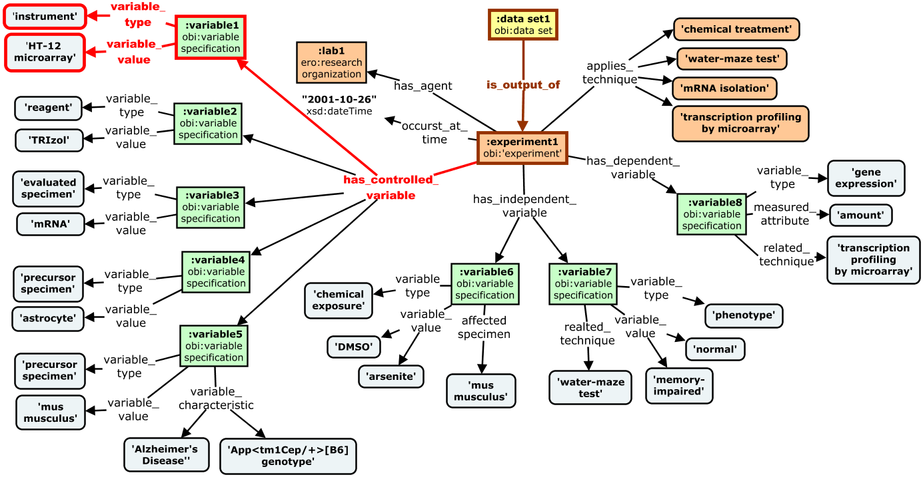
CQ1: "Find data sets produced using Illumina microarrays"
research object | control variable | independent variable | dependent variable
Notes:
So seeing as how our primary use case for this model is search and discovery, lets look at how it handles some competency questions . . .
We’ll start with a very simple one . .
The variable types are highlighted by color in the query and the graph.
Here we traverse the graph from the data set, through the experiment to a controlled variable node that captures the instrument used

Slide 31
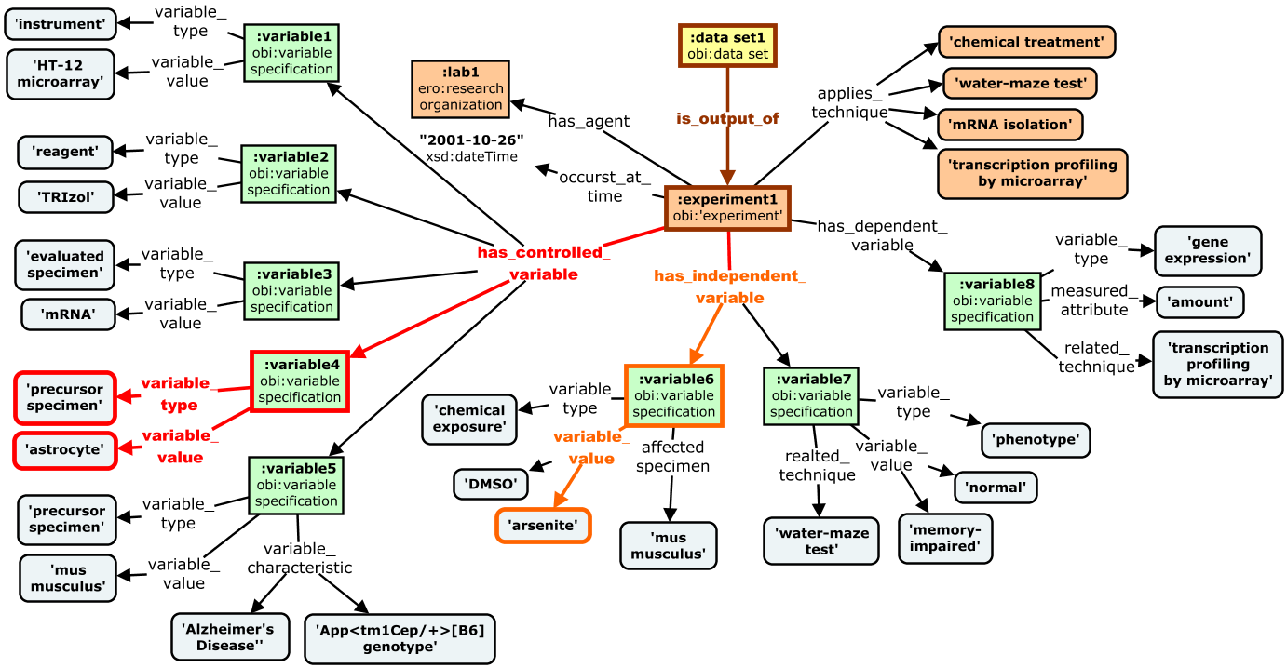
CQ2: “Find data sets about the effects of arsenite exposure on the brain”
research object | control variable | independent variable | dependent variable
Notes:
This second one is based on a specific type of independent and controlled variable – looking for data sets . . .
Note that if ontologies are used, queries like this can be answered even if curators assert only the specimen is derived astrocytes, as the link from the cell type to the brain is captured in background knowledge

Slide 32
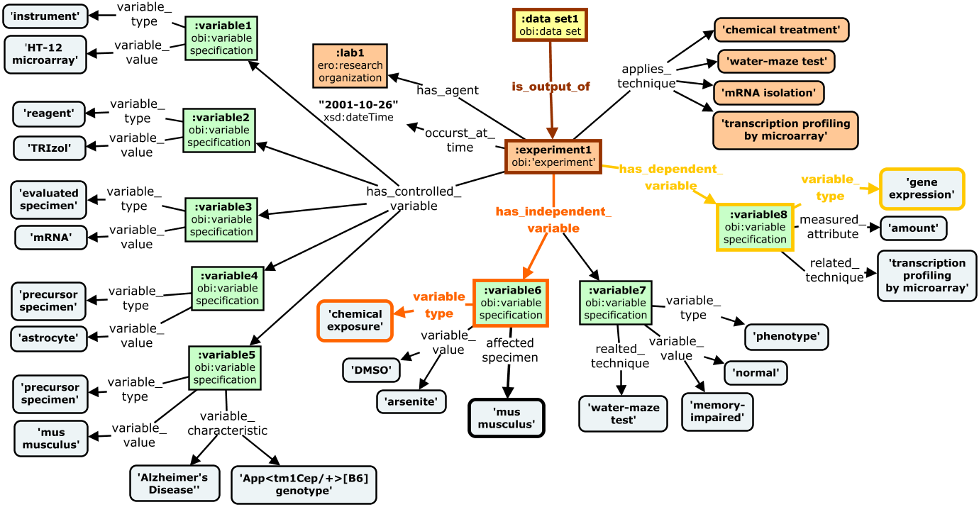
CQ3: “Find data sets about the impact of chemical exposure on gene expression ”
research object | control variable | independent variable | dependent variable
Notes:
This third one requires the model to capture an independent variable – dependent variable link – lokking for data sets about the effect of chemical exposure on gene expression

Slide 33
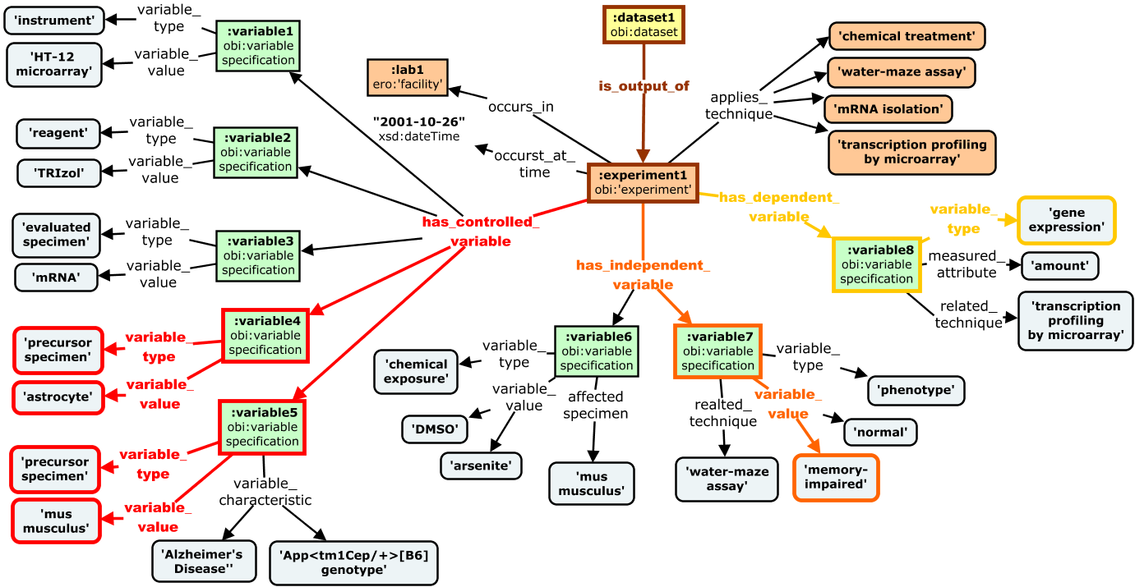
CQ4: “Find data sets about gene expression in astrocytes of mice with cognitive-defects”
research object | control variable | independent variable | dependent variable
Notes:
This final one requires information about all three variable types . . . looking for data sets about . . .
This is a very complex query but the model handles it in a relatively efficient manner

Slide 34
IV. Applications and Future Directions
1. Partnering with the Community
Establish a FORCE11 Working Group
Inform Open Research Information Framework (OpenRIF) efforts
evolution of VIVO/eagle-i developer community
Work with BD2K Data Discovery Index Metadata WG (bioCADDIE)
Notes:
So I want to quickly close by highlighting some potential applications and future directions for this work
In terms of how we might partner with the community, our next step is to establish a broader working group under the FORCE11 framework focused on these issues to promote, improve, and apply our work
We can also partner with the OpenRIF to inform their work. OpenRIF is the new name for working group we are leading that was historically associated with the VIVO-ISF standard – and we are beginning work to improve and expand modeling of attribution, provenance for research artifacts.
Finally, we also have contacts with with BD2K Data Discovery Index Metadata WG.
This is work that began after i completed the contract work presented here. Part of the larger NIH BD2K Initiative, which funded the bioCADDIE team at UCSD to build a data discovery index.
This is to be a system to index metadata about biomedical datasets across repositories using a common model, and a search interface to support discovery and sharing.
Metadata working group was tasked to define a model that could be used to aggregate metadata across existing data repositories under a unified framework (very similar to the goal of my work for Elsevier).
I have done an initial comparison of their model and my proposals, and can discuss details if there is interest and time - overall a very similar selection of core domain concepts but some critical differences in the way these are hooked together to define a metadata schema.
Our work has been shared with bioCADDIE DDI metadata team, and we are on their external advisory panel. But not significant interaction yet due to lack of bandwidth and resources on our part. Looking in new year for opportunity to work with them – maybe secure pilot project funding to evaluate and iterate on the model?
------------------
- I think it is actually pretty good. v1 is essentially a more formally specified and complex version of the ISA model (not surprising given it was created by same group)
- Very similar in scope and perspective as our straw man (albeit much more extensive and granular in its detail).
- Key issue for me is that the core notion of independent and dep variables are imprecisely defined, inconsistently captured, poorly constrained.
- Does not take a variable centric approach.
- Again, similar set of entities in the model, but distinctions between concepts and relationships between them in the bioCADDIE work led to a much richer and more complex model
- Goes into deeper detail and granularity than I think is needed for a purely discovery use cases, but I suspect they are starting as comprehensive as possible to best align with existing work, and can scale down for specific applications in the future.
- Approach was very similar as well:
top down (learn from existing standards, schema, and systems)
bottom up (CQ driven derivation of metadata elements)

Slide 35
BD2K Data Discovery Index (DDI)
Grant funded the bioCADDIE group (UCSD) to build a system to index metadata about biomedical datasets across repositories using a common model, and provide search interface for discovery
Metadata working group was tasked to define a model that could be used to aggregate metadata across existing repositories under unified framework
Version 1 of their metadata specification is here. DDI white paper is here.
Notes:
This is work that began after i completed the contract work presented here. Part of the larger NIH BD2K Initiative, which funded the bioCADDIE team at UCSD to build a data discovery index.
This system will index metadata across diverse biomedical data repositories using a common model, and build a search interface to support discovery and sharing.
Metadata working group was tasked to define a model that could be used to aggregate metadata under a unified framework (very similar to the goal of my work with Elsevier).
(I have done an initial comparison of their model and my proposals, and can discuss details if there is interest - overall a very similar selection of core domain concepts but some critical differences in the way these are hooked together to define a metadata schema.)
Our work has been shared with bioCADDIE DDI metadata team, and we are on their external advisory panel. But not significant interaction yet due to lack of bandwidth and resources on our part. Looking in new year for opportunity to work with them – maybe secure pilot project funding to evaluate and iterate on the model?
-------------
Since I completed this work, the NIH BD2K initiatives began, including the Data Discovery Index project.
Goal of this effort is to build a system to index metadata across all biomedical repositories using a common metadata model, and provide advanced search interface for discovery
Metadata working group was tasked to define a model that could be used to aggregate metadata across existing repositories under unified framework
. . . essentially the same specifications and task as we were in our pilot project - scope is interoperability and discovery, aim is to index dispersed datasets, but focus is on biomedical data.
Approach was very similar as well:
top down (learn from existing standards, schema, and systems)
bottom up (CQ driven derivation of metadata elements)
Scoped for discovery use case
I think it is actually pretty good. v1 is essentially a more formally specified and complex version of the ISA model (not surprising given it was created by same group)
Surprisingly similar in scope and perspective as our straw man (albeit much more extensive and granular in its detail).
Key issue for me is that the core notion of independent and dep variables are imprecisely defined, inconsistently captured, poorly constrained.
Does not take a variable centric approach

Slide 36
IV. Next Steps and Future Directions
2. Applications for Elsevier Projects
Landscape analysis
Who to partner with? What models to re-use or align with?
Glossary and conceptual model
Shared terminology for internal communication , documentation, models
Guide communication and alignment with broader community
General Metadata Requirements
Guide early iterations of internal metadata schema for developing systems
Inform selection of existing standards to adopt or align with
Experimental Metadata Model
Guide later iterations of internal metadata schema for systems
Inform development of community standards to unify metadata representation for research objects
Notes:
As for applications for Elsevier projects, our landscape analysis can help identify. . .
-------
Highlight vocabularies to leverage as value constraints for metadata collection

Slide 37
IV. Next Steps and Future Directions
3. Broader Challenges for Community
Adopting a common conceptual framework to underlie model and terminology
Achieving consistent and robust use of community CVs/ontologies as value constraints
Documentation standards and practices
Mechanisms for translating between schema
Incenting researchers to contribute
Notes:
Finally, some of the broader challenges this work highlighted for the community are listed here
There is a need to adopt . . .
A significant challenge relates to achieving . . .in practice
We noted a need for improved documentation standards and practices
and Mechanisms for translating between schema that capture data at different levels of granularity or for different use cases
Finally, the groundwork needs to be done to incent . . . many approaches here, but ultimately we need buy in from this community if we are to get quality metadata about research objects
------
Adopting a common conceptual framework to underlie model and terminology
Achieving consistent and robust use of community CVs/ontologies as value constraints
Documentation standards and practices
Mechanisms for translating between schema
Standards and practices for identifiers and versioning
Incenting researchers to contribute

Slide 38
Thank You!
Acknowledgements
Elsevier Research Data Services
Anita deWard
Oregon Health and Sciences University
Melissa Haendel
Universidad Politécnica de Madrid
Olga Ximena Giraldo
Ongoing work on this project hosted on GitHub:
https://github.com/OHSU-Ontology-Development-Group/experimental-metadata-model

Slide 39
BD2K Data Discovery Index (DDI)
Grant funded the bioCADDIE group (UCSD) to build a system to index metadata about biomedical datasets across repositories using a common model, and provide search interface for discovery
Metadata working group was tasked to define a model that could be used to aggregate metadata across existing repositories under unified framework
Version 1 of their metadata specification is here. And DDI white paper is here.
Notes:
Since I completed this work, the NIH BD2K initiatives began, including the Data Discovery Index project.
Goal of this effort is to build a system to index metadata across all biomedical repositories using a common metadata model, and provide advanced search interface for discovery
Metadata working group was tasked to define a model that could be used to aggregate metadata across existing repositories under unified framework
. . . essentially the same specifications and task as we were in our pilot project - scope is interoperability and discovery, aim is to index dispersed datasets, but focus is on biomedical data.
Approach was very similar as well:
top down (learn from existing standards, schema, and systems)
bottom up (CQ driven derivation of metadata elements)
Scoped for discovery use case
I think it is actually pretty good. v1 is essentially a more formally specified and complex version of the ISA model (not surprising given it was created by same group)
Surprisingly similar in scope and perspective as our straw man (albeit much more extensive and granular in its detail).
Key issue for me is that the core notion of independent and dep variables are imprecisely defined, inconsistently captured, poorly constrained.
Does not take a variable centric approach

Slide 40
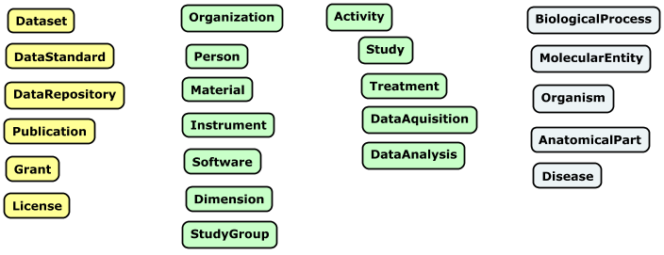
Core Concepts in bioCADDIE Model
Information
Artifacts
Experimental Concepts
(processes, participants, roles)
Biology Domain
Concepts
Similar set of core concepts represented when compared to our Experimental Metadata Model (EMM)
But key areas where the model created from these concepts don’t align with our model (see report here).
Notes:
Concepts identified as core in their model align well with our work . . .
Note how many concepts collapsed and conflated that we felt needed to be teased apart and represented more clearly.
In particular, the notion of experimental variables was not clear or prominent in the bioCADDIE model.

Slide 41
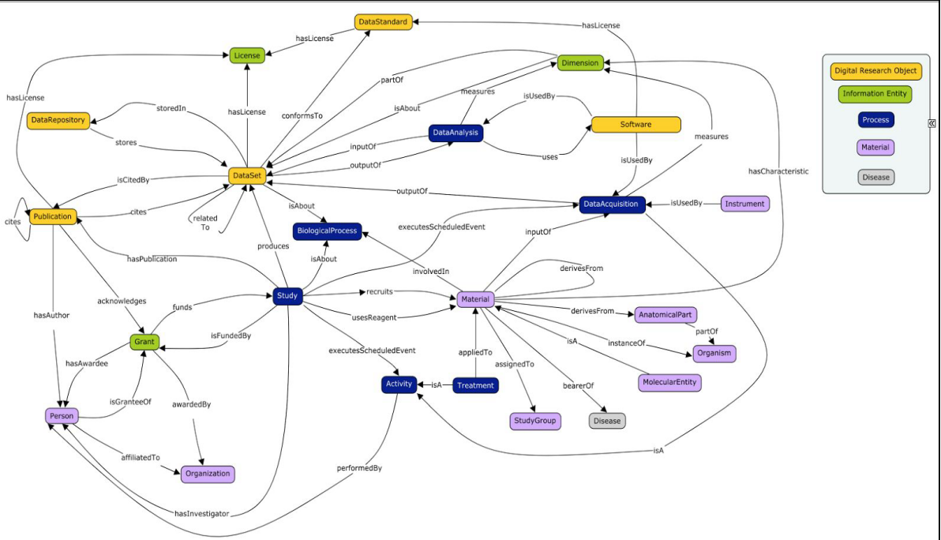
Overview of bioCADDIE Concepts and Relationships
https://github.com/biocaddie/WG3-MetadataSpecifications
Notes:
But the distinctions between concepts and relationships between them in the bioCADDIE work led to a much richer and more complex model
Goes into deeper detail and granularity than I think is needed for a purely discovery use cases, but I suspect they are starting as comprehensive as possible to best align with existing work, and can scale down for specific applications in the future.
give example for reviewing GEO dataset example
and again, the perspective is very different – not centered on variables. In fact it is very hard to tease out the dependent and independent variables for a given dataset in a clear and consistent way. This is my biggest critique of the model.
outcomes / comparison to my model
size of model larger
figure illustrating model
concept a big more broadly scope than my glossary (includes info artifacts and biology-specific domain concepts ) - but core experimental concepts are essentially the same
my thoughts/evaluation of the model
Evaluation of a bioCADDIE model. Seems like more than is necessary for a strict discovery use case. But this may be intentional, anticipating extensions and alignment for other use cases.

Slide 42
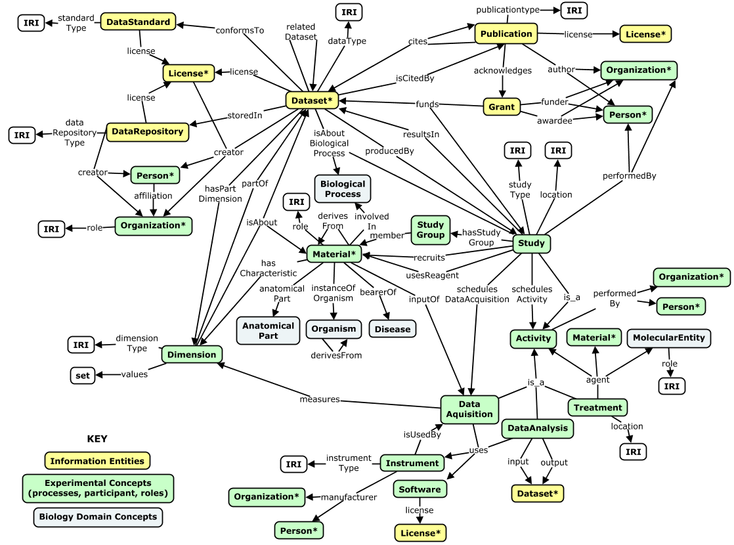
Overview of bioCADDIE Concepts and Relationships

Slide 43
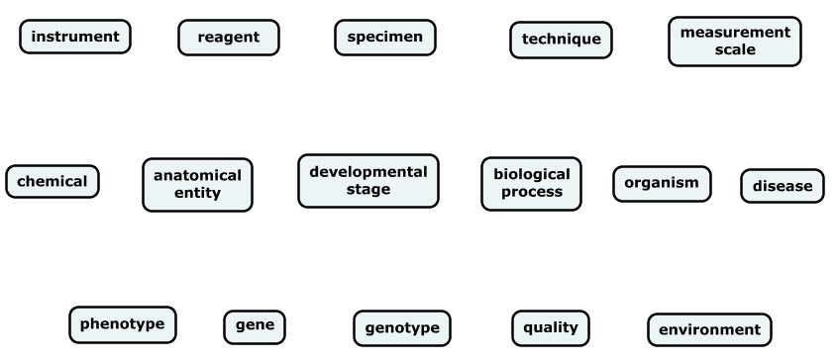
IV. Applications and Future Directions
2. Applications for Elsevier Projects
OBI, ERO
ERO, ReO
OBI, ERO
OBI, ERO
OBI, ERO
ChEBI
Uberon
Uberon
GO-BP
NCBI Taxon
DO
UPheno
NCBI Gene
GENO, Monarch
PATO
ENVO

Slide 44
Model Description
Different color for each ‘level’ in the model - try to limit the number of levels for ease of data collection and queries.
Experiment in orange is focal point. At this level we collect provenance metadata about the experiment rather than the dataset such as who performed it and when. We also link it to specific techniques applied in the experiment.
The next level in green is where we clearly see the focus of the model around experimental variables. Terms from CVs and ontologies that represent key features of the experiment are organized around these variable specification nodes. We believe that this approach provides just the right context for supporting discovery use cases and competency questions. (we will explore this in a minute)
Looking at the dependent variable first - the entity and attribute measured in an assay
we see that this specification describes entity and attribute measured in an assay (namely the level or amount of gene expression) as well as the optional indication of the specific technique used for measurement. And in parentheses are ontologies where these terms could come from.
Next we can look at the independent variables - again this represents parameters intentionally varied to test affect on dependent variable
There are two independent variable specifications in this experiment, one is a chemical exposure that specifies dmso and arsenite to different study groups, and the other is a phenotype variable that specifies normal vs memory impaired.
additional properties can be used to record things like the type of specimen affected, and the specific technique used to apply or determine the variable.
and again, we indicate CVs or ontologies where these terms might come from to control value entry.
Finally, controlled variable are parameters not varied across study groups
These specifications follow similar pattern. They allow description of reagents and devices that are not varied in the experiment, as well as specimen types and features that are held constant.
This gets a wee bit nuanced when it comes to describing specimens - here we define the notion of the evaluated specimen - that mRNA the material that was actually input into the assay, and precursor specimens that allow you to describe where it came from. Here this is astrocytes and mus musculus. We capture these because they represent potentially useful hooks into discovering this dataset.
Note that the model supports additional descriptors and qualifiers to provide additional information about these variables, such as the mouse being a model of a disease, or its genotype.

Slide 45
Model Description
Different color for each ‘level’ in the model - try to keep to 3-4 levels for ease of data collection and queries.
Rectangles represent instances, rounded boxes represent classes from community ontologies used as standardized descriptors of variables.
Experiment in orange is focal point. Provenance metadata here are about the experiment (not the RO). Note support for 'keyword' type links to techniques/methods applied and experimental designs followed.
Below this we clearly see the focus on our three types of variables.
Green nodes represent 'variable specifications' that serve as hubs for aggregating information about a given variable that needs to be grouped for answering queries. These contextualize variables, in an extensible way if more detail is desired
Independent variables
A key independent variable in our experiment is the cellular phenotype of the source specimens. a variable type link records the general type of thing that is varied, and the variable_value link records the values it takes in the experiment.
Similarly for the chemical treatment variable.
Note that this pattern allow users to find this dataset by searching for experiments where type of chemical treatments is varied, or based on specific chemical values.
Also support for capturing other important information contextualizing how the variable was applied (affected specimen, related techniques or conditions)
Dependent variables
Specification here describes the type of thing that varies (gene expression), and the attribute measured (amount), as well as the technique used for measurement, and related conditions for the measurement
Control/constant variable
These specifications follow similar pattern. They allow description of reagents and devices that are not varied in the experiment, as well as specimen types and features that are held constant.
Note that the model supports additional descriptors and qualifiers to provide additional information about these variables (not shown here)
All rounded blue boxes would ideally be terms from an ontology to constrain value entry and leverage knowledge encoded in structure /axioms of ontologies . . .but this is a challenge, and likely a longer term goal as support for use of ontologies in curation systems improves

Slide 46
Key Features
Variable-Centric: Variable specification instances serve as central organizing nodes that describe variable type and values.
Sets apart from other models, which tend to be workflow or specimen centric, and is key for balancing utility for search with minimal curation burden
abstracts away some details to provide more direct/efficient links from ROs to variable descriptions
Most efficient way to represent all key entities and provide enough context to support CQs
captures just enough context – focuses on experimental variables and creates direct relationships to key biological concepts
Core/proximal concepts are universal
Experimental variables are universal paradigm across disciplines that describes how entities participate in an experiment
Optional extensions record additional context/granularity: Imparts low initial curation burden that is scalable for extended use cases
Additional info about specimens, techniques, conditions can be collected as needed by different applications - but the core value of variable types and values can be collected independently of this other metadata
Dependencies ordered so description of primary features (variables) is not dependent on secondary features (processes)
Captures types over instances: abstracts away similarities between specimens to eliminate redundant representation of concepts.
Don’t represent each specimen or measurement, just the shared set of features that describe them
Direct re-use of use community vocabularies/ontologies: constrains data entry in variable descriptions, with terms coming from community CVs/ontologies
overhead to this in entry and tooling, so early iterations of applications based on this model may capture free text initially
Parsimonious (manageable size/complexity): Implements a relatively small set of classes and properties, which results in less precise semantics, but simplifies model/data entry, and simplifies queries

Slide 47
Key Features and Benefits
Focus is on ‘Experimental Variables’ (not workflow or specimens)
Variable specification instances serve as central organizing nodes that describe variable type and values. This approach abstracts away some details to provide more direct/efficient links from ROs to variable descriptions.
Extensible to record as much context around variables as is needed for a given use case
Related specimens, techniques, conditions can be collected as needed by different applications - but the core value of variable types and values can be collected independently of this other metadata
Imparts low initial curation burden that is scalable for extended use cases
Dependencies ordered so description of primary features (variables) is not dependent on secondary features (processes)
Direct re-use of use community vocabularies/ontologies in variable descriptions
Constrains data entry in variable descriptions, with terms coming from community CVs/ontologies
Manageable size/complexity
Implements a relatively small set of classes and properties, which results in less precise semantics, but simplifies model/data entry, and simplifies queries
e.g. a single specimen_feature property is used to capture any characteristic of a specimen
Notes:
Variable centric - Focus is on ‘Experimental Variables’ (not processes/workflow)
Variable specification instances serve as central organizing nodes that describe variable type and values. This approach abstracts away some details to provide more direct/efficient links from ROs to variable descriptions.
Core/proximal concepts are universal across disciplines
Experimental variables are universal paradigm that describes how entities participate in an experiment
Beneficial because the notions of controlled, independent, and dependent variables are shared across disciplines
granularity and domain-specificity added distally via optional properties and selection of CVs,
Cuts the ‘fat’
low info content nodes/levels to traverse to get to ‘hooks’ (key search terms) for discovery - minimal number of levels/nodes (query efficiency , and reduces curation burden). minimal instance creation.
Focus on type
Direct re-use of use community vocabularies/ontologies in variable descriptions
Constrains data entry in variable descriptions, with terms coming from community CVs/ontologies
direct re-use of CV/ontology terms. Abstracts away similarities between specimens to eliminate redundant representation of concepts.
most efficient way to represent all key entities and provide enough context to support CQs (i.e. aspects most important for researchers to discover, understand)
captures just enough context – focuses on experimental variables and creates direct relationships to key biological concepts
Manageable size/complexity
Implements a relatively small set of classes and properties, which results in less precise semantics, but simplifies model/data entry, and simplifies queries
-------------------------
Primary goal is to be explicit about the role different entities play in the experiment in concise a way as possible (not only capture the what, as many repos do with keywords but the how)
Model is concise because it focuses on the types of things that are involved, and does not distinguish separate instances of each type where it is not necessary
(specifically, captures type of specimens, and types of assays, but no instantiate each separate one as some other models do . . .this is one plce we are able to be concise)
Make separate slide for each of these?
One slide on constraining value entry – unambiguous reporting, comprehensive, consistent and interoperable data
and one focusing on how esp important for variable specification – show my variable hierarchy
extensibility/interoperability:
1. captures for elements first, for simplest use cases, and can extend from these proximal nodes in the graph to capture more detail/precision/distinction as needed
2. define patterns/rules for shortcutting and expanding the model to translate between dtasets annotated at different elvevel of granularity and precision (rdf transforms, macros, etc)

Slide 48
Context of Application
Electronic Lab Notebook (Hivebench)
Capture metadata at point of practice, in research workflow
Research Object Repository (Mendeley)
Share curated data and resources across the research cycle
Integrated Data Search Platform
Discovery of data and other research objects across disciplines and systems
Abstract and Citation Databases (Scopus, Science Direct)
Literature search and citation analysis
Research Intelligence Services (SciVal, PURE)
Evaluation of research strategy, performance, and impact, connect experts, and identify trends and funding sources
Notes:
CONSIDER JUST PASTING LOGOS / NAMES FOR EACH SYSTEM ON TOP OF RESEARCH CYCLE DIAGRAM – AND MENTIONING THAT ELSEIVER IS DEVELOPING CUTTING EDGE PRODUCTS ACROSS FULL CYCLE, WHICH SETS THE CONTEXT FOR APPLYING THE WORK I HAVE BEGUN.
As you all know Elsevier has been at the leading edge deriving science into this new era, through its development of innovative RDM platforms . . . here are some examples . . .
Hits steps across the research cycle we just reviewed
And this sets the context for the work I did, and discussions with developers of these products provided use cases and requirements that drove our modeling work
---------------
Modeling use cases and requirements driven by evolving systems and services where this model would operate
Project coming at a time when many new RDM systems being developed . . .
Had conversations with developers . . .
Note that these target steps and objects across this life cycle
Add publication services
Have anita spruce up this slide?
---------
New inputs to support evaluation of research strategy, performance, and impact identify strengths, connect experts, and identify trends measure and promote accomplishments/impacts, connect collaborators, identify funding opportunities (evaluate research strategy and performance)
see https://www.elsevier.com/research-intelligence

Slide 49



X
Research objects are information artifacts that are utilized or produced in the research lifecycle
funding proposals
curated
shared/archived
data sets
protocols
experimental
records
DATA SEARCH
primary
datasets
data management
plans
publications
presentations
secondary
datasets
code / pipelines
progress
reports
Project
project repositories
(github, OSF)
Metadata about research objects is becoming increasingly important in todays data intensive research paradigm
Notes:
CONSIDER HAVING A SLIDE AT THE END (NEXT STEPS) THAT TALKS ABOUT ELSEVIER SYSTEMS THAT MIGHT BE INFORMED BY THIS WORK
As you all know Elsevier has been at the leading edge deriving science into this new era, and it evolving set of RDM products gave context to my project work.
Here are some examples . . .
Electronic Lab Notebook (Hivebench)
Capture metadata at point of practice, in research workflow
Research Object Repository (Mendeley)
Share curated data and resources across the research cycle
Integrated Data Search Platform
Discovery of data and other research objects across disciplines and systems
Abstract and Citation Databases (Scopus, Science Direct)
Literature search and citation analysis
Research Intelligence Services (SciVal, PURE)
Evaluation of research strategy, performance, and impact, connect experts, and identify trends and funding sources

Slide 50
Applications for this Work
Facilitate Internal Efficiencies
Conceptual alignment and communication
Uniform collection of metadata across Elsevier systems
Support Community Integration
Metadata integration for search across external systems and research domains
Inform community metadata standards for research objects (a universal metadata layer)
Notes:
So why did Elsevier contract us to do this work – what applications did they anticipate it having. (Anita feel free tot correct me if I misstate or leave anything out here)
My take on this is that there are two levels or stages of application.
The first is to facilitate . . . by supporting within and across units in the Elsevier organization
The second is to support broader efforts requiring alignment and integration across the research community
support metadata integration . . . (relevant for systems such as Mendeley Data Repository and Integrated Data Search Platform
inform development of community metadata standards

Slide 51


Applications for this Work
Facilitate Internal Efficiencies
Conceptual alignment and communication
Uniform collection of metadata across Elsevier systems
Support Community Integration
Metadata integration for search across external systems and research domains
Inform community metadata standards for research objects (a universal metadata layer)
DATA SEARCH
Notes:
So why did Elsevier contract us to do this work – what applications did they anticipate it having. (Anita feel free tot correct me if I misstate or leave anything out here)
My take on this is that there are two levels or stages of application.
The first is to facilitate . . . by supporting within and across units in the Elsevier organization
The second is to support broader efforts requiring alignment and integration across the research community
support metadata integration . . . (relevant for systems such as Mendeley Data Repository and Integrated Data Search Platform
inform development of community metadata standards

Slide 52
X
. . . But They Still Have Much to Offer
Converge on central relationship between techniques, specimens, and variables
Experimental variables are universal paradigm that describes how entities participate in an experiment
Captures the aspects most important for researchers to discover, understand, and analyze it on their terms
This perspective is necessary to answer queries about cause and effect
“Find datasets that measure the effect of chemical stress on hippocampal action potential activity”
Notes:
A universal paradigm that describes how entities participate in an experiment
Captures the aspects most important for researchers to discover, understand, and analyze it on their terms
This perspective is necessary to answer queries about cause and effect (what factors were applied to test an outcome of interest)
Evaluation of CQs and existing models all pointed to a central importance of describing these three aspects of experiments and the relationship between them, which is something we took to heart in defining our initial model

Slide 53
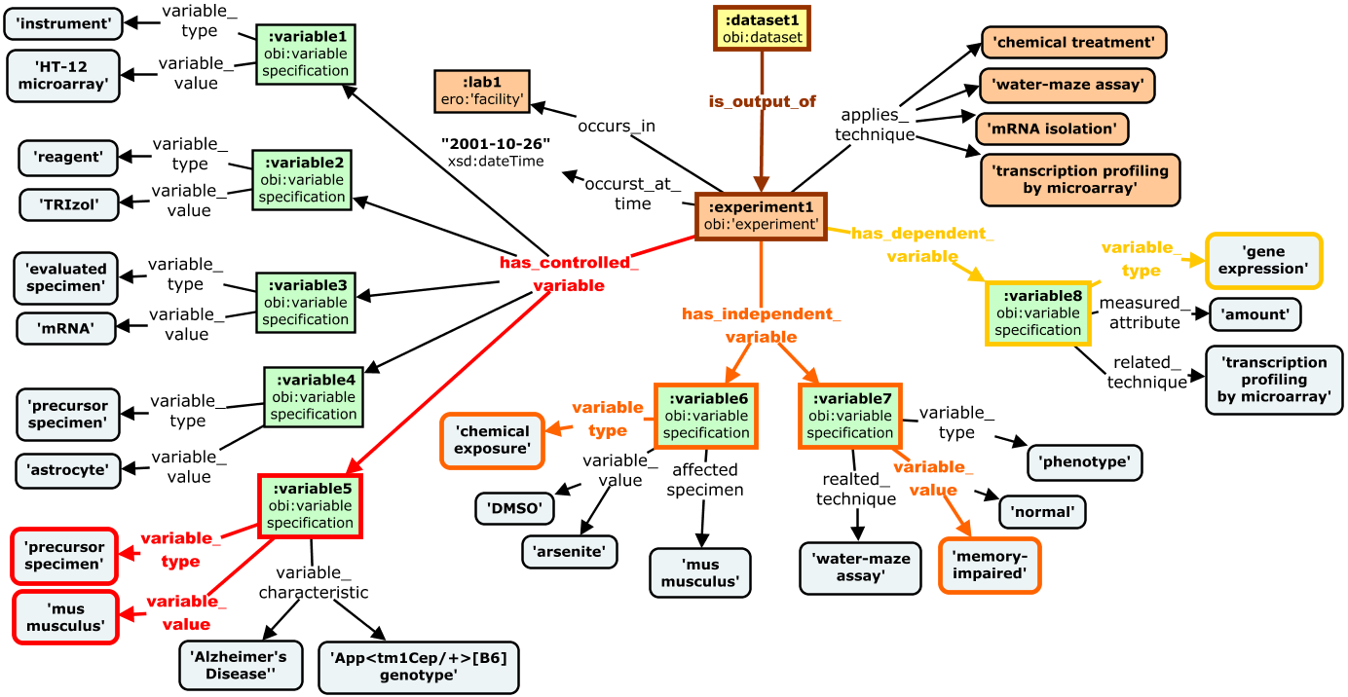
CQ5: "Find gene expression data about the effect of chemical stress in mice with memory defects"
Notes:
IDEA: take a couple CQs and trace path to answer

Slide 54
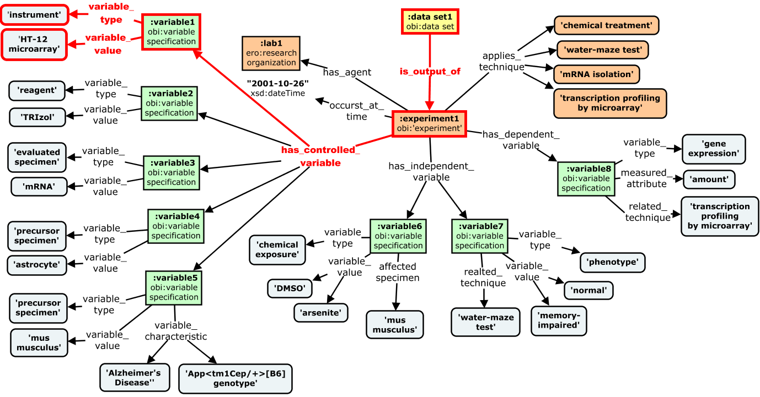
CQ1: "Find datasets produced using Illumina microarrays"
Notes:
Seeing as how our primary use case for this model is search and discovery, lets look at how it handles some competency questions . . .
IDEA: take a couple CQs and trace path to answer

Slide 55
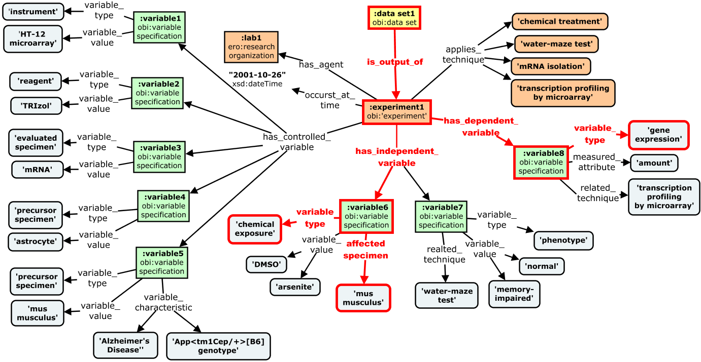
CQ2: “Find datasets about the impact of chemical exposure on gene expression using mouse models"
Notes:
IDEA: take a couple CQs and trace path to answer

Slide 56

CQ3: "Find data about the effects of arsenite exposure on the brain"
Notes:
Independent variable – dependent variable link
Note that if ontologies are used, queries like this can be answered even if curators assert that the specimen is derived from brain, (as the link from the cell type to the brain is captured in background knowledge)
IDEA: take a couple CQs and trace path to answer

Slide 57
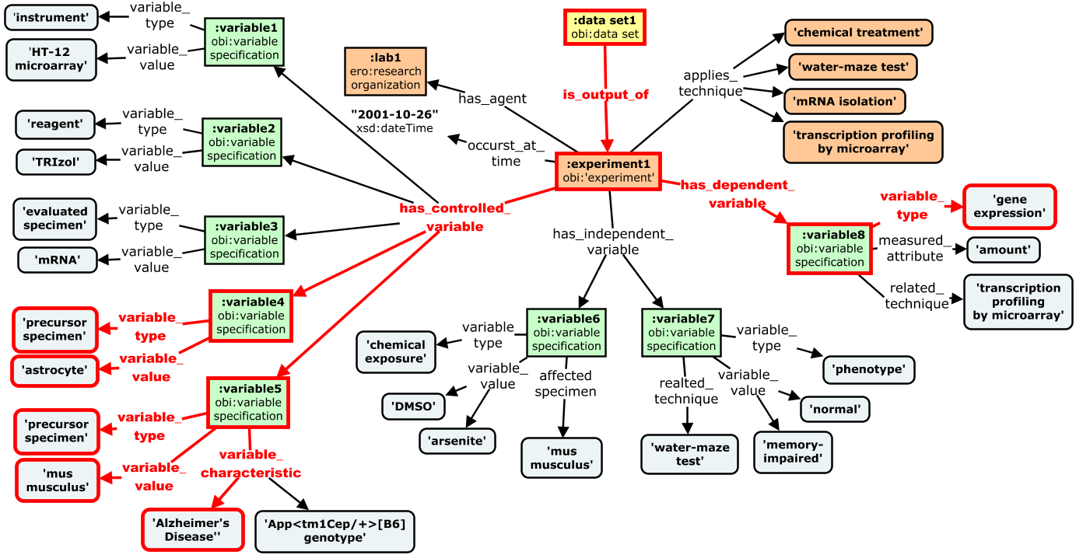
CQ4: "Find data about gene expression in astrocytes from mouse models of Alzheimer’s"
Notes:
Similarly here, ontologies are used, queries like this can be answered even if curators assert that the mouse is an Alzheimer’s model (as the link from the genotype to the disease is captured in background knowledge)
IDEA: take a couple CQs and trace path to answer

Slide 60
Evaluate by mapping experimental metadata records
GEO

Slide 61
Next steps.
Formally specify and document the model.
Formally test the model and iteratively improve.
Use model to describe metadata from real data set examples.
Explore interoperability with DDI-bioCADDIe model.
Formal working group enforce 11
Coordinate efforts with bio CADDIE working group.

Slide 63
Limitations and Pitfalls
Conceptual hurdle of abstracted variable-centric approach
no directly capture the real experimental workflow
loose a process based view of the experiment and how specific individuals participate along the way
Curation burden if values are to come from CVs/ontologies
good tooling can only go so far to ease standardized term selection
Certain queries aren’t answerable (at least not with exact specificity)
i.e. can be asked but may return false results . . .e.g. questions about which specimen a feature inheres, or order of application of variables?
Lacks detail for providing complete picture of an experiment, reproducibility
but this is not primary use case
Most nodes are not extensible (CV terms)
so extensible in ways deemed important for facilitating RO discovery across domains and interoperability of data, but not extensible to support other use cases)
Based on many assumptions that may not be accurate, and not yet tested against diverse set of data and CQs

Slide 64
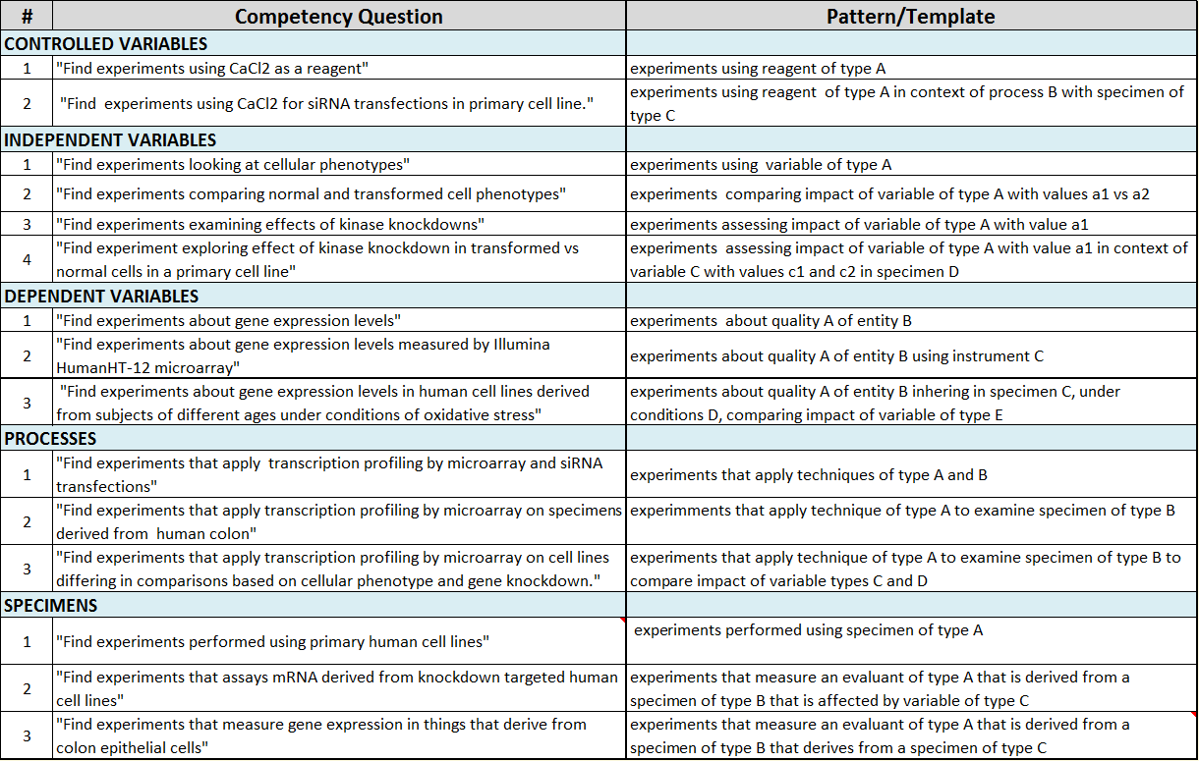
Evaluation Using Competency Questions

Slide 65
Deliverable Summary
1. Landscape Analysis: High level review of models, standards, systems
Outcome: curated dataset to identify relevant and re-usable efforts (link), and detailed evaluation of existing protocol repositories (link)
2. Model Evaluation: Focused analysis of most relevant models and standards
General Metadata: HCLS, DC, DCAT, FOAF, PROV/PAV, . . .
Experimental Metadata: OBI, ISA, KEfED, EBI, CSMO
Outcome: Conclusion that general metadata needs are well supported (link), but no experimental metadata models support our use cases and requirements
3. Requirements and Use Cases: from domain experts, Elsevier, and literature
Outcome: limited set of user stories, competency questions, limited application or workflow requirements (link) . . .more work needed here
4. Reference Glossary and Conceptual Framework: Defined core domain concepts and relationships as shared framework for communication
Outcome: glossary and reference model of experimental activities/artifacts (link)
5. Implementable Metadata Model and Recommendations
Outcomes:
(1) General Metadata Recommendations (link),
(2) Experimental Metadata Models proposals (link)
Notes:
Apologies for this but wanted to keep this all on one slide as a single point of reference.
This just summarizes some of the work we have done to date, and provides links to relevant documentation
. . . and the last two we will talk about in more detail today
--------------
proposals for discussion and iteration - not formally specified/encoded (yet)

Slide 66
END

Slide 68
How We Are Getting There . . .
Landscape Analysis: what has been done before
Reference Conceptual Framework: comprised of a concept glossary and high-level domain reference model
supports aligned understanding of the concepts in our domain/systems and terms to refer to them
Metadata Model(s): formal schema to be implemented in applications
structure data and support query and data publication use cases
Notes:
These things inform and feed off each other in a cycle of iteration and improvement
Goals for today: Review these activities/artifacts, with primary focus on Requirements and Metadata Models. Specific requirements and use cases are essential for scoping and structuring and evaluating any metadata model. Requirements and feedback have been limited so far, so a large part of our discussion today will revolve around understanding what these are, why they are important, and planning for their collection and evolution in the future.
Looking at a couple actual proposed models will help here (something we haven’t had before)

Slide 69
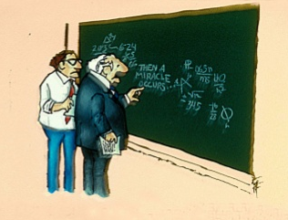
Reproducibility crisis
Failure to reproduce published experimental findings
“Drug Development: Raise standards for preclinical cancer research”, Begley, CJ, Ellis, LM, DOI:10.1038/483531a
Increased retraction rate for scientific publications
“Retraction rates are on the rise”, Cokol, M. et al DOI: 10.1038/sj.embor.7401143
Statistical evidence condemning reliance on p-values in the scientific method and publication standards
“Why Most Published Research Findings Are False” John P. A. Ioannidis DOI:0.1371/journal.pmed.0020124
Notes:
The reality is that we are amidst a reproducibility crisis where it is becoming increasingly apparent that many of the findings reported in the literature cannot be replicated.
- marked by a failure . . . , increased . . ., and statistical evidence . . .
This is a complex problem with a lot of factors at play, but it is clear that poor data literacy and management practices are partially to blame.
So while better metadata isn’t the only answer, I content it is a really important one.
So where can we improve . . .
--------------
C. Glenn Begley, who spent a decade in charge of global cancer research at the biotech giant Amgen, recently dispatched 100 Amgen scientists to replicate 53 landmark experiments in cancer—the kind of experiments that lead pharmaceutical companies to sink millions of dollars to turn the results into a drug. In March Begley published the results: They failed to replicate 47 of them.
Mark Liberman provides a more complete list of issues: “lack of replication, inappropriate use of ‘statistical significance’ testing, data dredging, the ‘file drawer effect’, inadequate documentation of experimental methods and data-analysis procedures, failure to publish raw data, the role of ambition and ideology, and so on

Slide 70
Importance of metadata in Research
Personal Information Management
metadata about personal by-products of daily research
facilitates work, publication, submissions of data
Discovery and Re-Use
metadata about end products of research made public
facilitates re-use, validation, extension
critical for modern research paradigms
Research Reproducibility
requires metadata creation across resource life cycle
facilitates re-use, validation, extension
Notes:
This brings us to some of the specific use cases for metadata in the research domain . . .
1 One critical application I just alluded to is toward personal information management.
Here we are largely concerned with metadata about personal by-products of day to day research - how local files are labeled and stored, what details are included in protocols and experimental records.
Keeps your work organized and facilitates publication, submissions of data, theses
2 A second use case for metadata is discovery and re-use of data on a broader scale
Here we are concerned with end products of research that are made public (publications, datasets, protocols).
Created when these products shared in a public repository
Trend toward data sharing driven top-down by mandates, bottom up by open science and research efficiency movements, and also by the availability of tools and methods for data aggregation and re-analysis (new paradigms and tools for data-driven and team science)
3 A third use case for metadata is research reproducibility on a broader scale
Here we are concerned with research products across their entire life cycle
As we saw with the idea of info entropy, capturing metadata as data is created is critical for its precision and richness, and summarizing in comprehensible way when made public is critical for
Facilitates re-use, validation, extension
Key requirement for ‘research reproducibility’ (the ability to validated, reproduce, and extend research findings)
This principle is in jeopardy as more and more papers are being retracted and findings found irreproducible – eroding pillar of scientific research and trust of public.
Poor metadata practices are significant contributor to these problems.

Slide 71
Importance of metadata in Research
Credit/Attribution
Leverages metadata about who contributes to resources and how
Altmetrics providing new paradigms for evaluating impact
Secondary Analysis
Metadata can serve as data for analysis/evaluation
Publication Analysis Tools: reporting of trends and research impact, resource usage, citation networks
“What publications did the Neuroscience Program training grants support from 2009 to the present”
Publication Metadata Utilized: Author(s),Grant support numbers, Publication Year
Notes:
A fourth use case for metadata is to support credit and attribution around research resources
These efforts leverage . . .
we will hear more later today about Altmetrics paradigms for evaluating researcher impact using this type of metadata . . . and standards and tools emerging to support these efforts
And a fifth and final use case I will present is secondary analysis of metadata
Here metadata can serve . . .
One example here is from a publication dashboard reporting tool we are building at OHSU to support analysis of local research activity – things like research trends and impact, resource usage, and citation networks
We can ask questions like . . . using publication metadata about
-------------------------------
ORCID Benefits
standardized reference to person metadata
facilitates efforts to track productivity, impact, and attribution
resolves to a “CV” listing all scholarly contributions linked across systems (e.g. Pubmed, Scopus, Slideshare, Figshare, Github, Dryad, . . .) . . . mine: http://orcid.org/0000-0002-1048-5019
e.g. we are currently building a ‘Publication data dashboard’ to support reporting use cases around scholarly output of researchers and programs at ohsu
"hit" occurs when publication =
Postdoc or trainee AND mentor as authors
NGP trainee grants (with preprocessing for normalization)
Publication year 2008 >

Slide 72
Review of existing schema and standards
Standards: Existing schema and standards for experimental metadata insufficient
- standards not scoped for use cases (ISA, OBI)
- repository schema narrowly scoped for specific domain (Array express, GeO)
few more slides here

Slide 73
Existing Models Do Not Serve Our Needs . . .
OBI (Ontology for Biomedical Investigations) Broad and rich, but focus in on biomedicine, and not suited or being used as a metadata model/schema (too complex, tied to realist view)
ISA (Investigation-Study-Assay) A generic model that is widely used (e.g. Nature Scientific Data), but model is too complex and granular for our needs, their model for structuring LOD seems hasty and underdeveloped.
KEfED (Knowledge Engineering from Experimental Design) A generic high-level model with right level of abstraction/complexity, but underspecified ontological underpinnings and integration, receives limited use and tailored for data analysis use cases.
EBI (European Bioinformatics Institute RDF Platform) Built for discovery use case, but narrowly scoped for specific EBI systems (e.g. Array Express)
None support level of integration with existing ontologies to adequately constrain data entry

Slide 74
Landscape Analysis
What can we learn from existing work to inform our model?
What gaps and needs are outstanding (to meet our efforts)
What challenges will we encounter and partners might we engage in our integration efforts?
what metadata do systems collect?
how compatible are their schema?
what standards exist and are used?
where do gaps exist?
Notes:
Obvious first step for a project like this is to perform a landscape analysis. Answer two questions:
1. Level 1: What has already been done that we can use? (maybe someone else has solved our problem. If not what can we adapt and extend to met our needs?)
2. Level 2: What are we up against here – what are the open challenges and gaps that need to be addressed for us to execute level two
Scoping deliverables

Slide 75
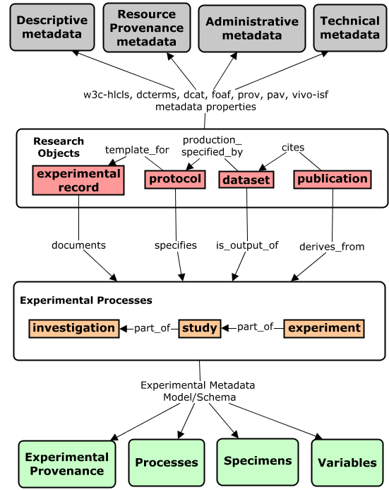
Metadata Framework
General
Metadata
Title, Contributors, Identifiers, Creation/Modification Dates, Version, Access Info, File size, File Format, Keywords
Directly describes research objects
Two types of
Research Object
Metadata
Experimental
Metadata
Indirectly describes
research objects by describing experiments related to them
Notes:
Conceptually (as I alluded to in the last slide) I distinguish two separate components of the research object metadata model we want.
A General Metadata model captures information that directly describes a RO, and an Experimental Metadata Model captures info describing experiments related to these ROs
This diagram that illustrates the difference schematically . . .
General metadata models are relatively simple, flat, and domain independent – cover descriptive, provenance, administrative, technical metadata.
Many good standards and repositories around general metadata exist (Dublin Core, DCAT, HCLS standard Dataverse, Dryad, DataCite, Figshare)
some examples of general metadata include . . . - these help users understand, utilize, and manage a resource, but not particularly useful for discovering them in the way researchers want (based on experimental features related to the data or protocol)
This is where the experimental metadata is useful . . . describing things like . . . (will return to how we arrived at this set of features in a few slides . . .) This is how researchers want to discover data!
But building a generic and re-usable model is challenging here due to the complexity and diversity of experimental practices and terminology across domains and communities.
This is the main challenge I have been thinking about as part of this project . . . because the state of the art here is pretty bleak . . .

Slide 77
Model Requirements for Data Entry and Discovery Use Case
Intuitive: aligns with implicit mental models of the research process that applies across disciplines
Parsimonious: balance precision with complexity needed for discovery and date entry use case
Captures the right perspective on the research process to support queries researchers care about
Minimize curation burden
Generic but Extensible: be suitable for diverse disciplines while supporting extensions for specific domains/use cases
Interoperable: re-use/align with existing models and data that can add value to our system
Use community CVs/ontologies to standardize data entry
Support integration of data across existing repositories
Facilitate data (LOD) that is amenable for third party use
‘Semantic’ – leverage ontologies to type and structure metadata

Slide 78
Notes:
What we learned:
Not surprisingly, lots of models and schema exist around research objects – some community standards and others bespoke schema for a specific repository.
The problem with the current landscape is that there is no common fundamental foundation that underlies and links everything. Find an image to capture this idea of no foundation.
And it's getting to the point now that there are so many data sets so many different models each designs with their own needs and perspectives in mind, that it is a near impossible challenge to align and integrate them.
We need to take a step back and agree on the meeting at relationships between key concepts underlying experimental research, and use this as a basis for a shared understanding, clear and efficient discourse in communication, and a starting point and guiding set of principles for any integration efforts. Now this is exactly the goal of domain reference ontology's such as OBi and Sio. And these models certainly informed our work. But to be practically useful a more focused set of concepts that are defined in the context of a specific use case, such as data said discovery and integration, is ultimately what will be useful in practice. And what can inform schema for collecting experimental metadata for these purposes.
what we aimed for was really a version of OBI scoped for a specific use cases (experimental metadata for discovery of research objects)
Beginning to address this need what's the goal of this project. We took a bottom up in a top-down approach to define and a short garments. Bottom up approach analyzed competency questions The researchers could potential he ask in order to discover and use data. The top down approach looked at what concepts in relationships were present in existing models and metadata schema.
Show a list of about 20 competency questions, and show a spreadsheet or concept map illustrating what is represented in . .

Slide 79
Example
The following list of variables provides a decent experimental description, even without understanding the precise experimental context
obi:FACS (technique)
reo:monoclonal antibody (reagent)
ChEBI:tamoxifen (drug)
cl:leukocytes (cell type)
ncbitaxon:mus musculus (organism)
mp:obesity (phenotype)
do:diabetes (disease)
go:gene expression (biological process)
pro:CD9 (protein/gene)
go:immune surveillance (biological process)

Slide 80
Challenge for us has been understanding requirements and use cases in order to scope the model
The primary aim of the domain metadata model is to efficiently link an experimental information artifact to the most relevant experimental 'variables'
includes experimental constants, independent variables, and dependent variables
The model should capture some level of context about how these variables participate in / related to the experiment
more than a flat list, but less than ISA/EBI/OBI
Variables should be captured using terms from domain CVs/ontologies
The model should support interoperable descriptions of different artifacts (datasets, protocols, experimental records)
The model should be general enough to cover different research domains and disciplines
The model should allow extensions for specific domains and use cases
Notes:
trade off between burden on data entry, and precision of queries that can be answered

Slide 81
Ongoing Work
RO landscape analysis (link)
Protocol Repository Comparison (link)
Concept Glossary (link)
Research Object Metadata
Protocol Document Model
General Metadata Schema (link)
Domain Model Models
Notes:
list of attributes and properties, but not a schema (i.e. not a specification for how to apply these properties in structuring/collecting metadata)

Slide 82
I. Landscape Analysis
Environmental Scan: Broad review of relevant communities, initiatives, standards, ontological models, and data systems (link)
Protocol Repository Evaluation: a deeper dive into existing protocol repositories, journal, wikis, etc. (link)
coverage and content
system functionalities
metadata schema
protocol structure
Notes:
Env Scan: what are others doing and how can this work for or against us
Protocol Eval: inform functional and metadata requirements for protocol/data repo

Slide 83
II. Reference Framework
Part 1. A Concept Glossary (link)
Dictionary of relevant domain concepts
Identify, define, distinguish key entities in our domain
Support a shared understanding of these concepts and what their instances are in reality and in our data
Provide a preferred terminology for referring to these concepts
Relates concepts to implementations in Elsevier systems
Will inform and align with model development

Slide 84
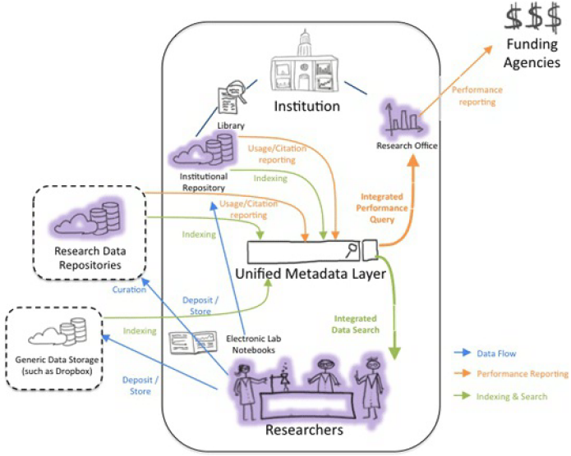
Why we care about open data (and other non-publication artifacts)
Publications offer limited , biased, obscured view of data
Promotes more open and rigorous science
Facilitates evaluation and interpretation
Permits contextualization in larger data landscape
Supports integrated data analysis
Facilitates reproducibility and extension
Supports more accurate and comprehensive assessment of research impact
Image created by Victor Henning and Anita de Waard, © 2013 Elsevier.
Notes:
publications always been a looking glass into the data that is fundamental to research. has worked fine but we can do better now
pubs offer limited , biased, obscured – becoming more apparent in an increasingly competitive and fragmented environment where it is harder to effectively evaluated and vet findings.
promotes more open and rigorous science (when even your data is exposed)
facilitates evaluation and interpretation
permits contextualization in larger data landscape
supports integrated data analysis / meta-analyses
facilitates reproducibility and extension
supports more accurate and comprehensive assessment of research impact
This is a great figure summarizing the RDM applications and workflows from a report by Anita and Mike Lahruhn

Slide 85
Why we care about open data (and other non-publication artifacts)
Publications offer limited , biased, obscured view of data
Promotes more open and rigorous science
Facilitates evaluation and interpretation
Permits contextualization in larger data landscape
Supports integrated data analysis
Facilitates reproducibility and extension
Supports more accurate and comprehensive assessment of research impact
Image created by Victor Henning and Anita de Waard, © 2013 Elsevier.
Notes:
publications always been a looking glass into the data that is fundamental to research. has worked fine but we can do better now
pubs offer limited , biased, obscured – becoming more apparent in an increasingly competitive and fragmented environment where it is harder to effectively evaluated and vet findings.
promotes more open and rigorous science (when even your data is exposed)
facilitates evaluation and interpretation
permits contextualization in larger data landscape
supports integrated data analysis / meta-analyses
facilitates reproducibility and extension
supports more accurate and comprehensive assessment of research impact
This is a great figure summarizing the RDM applications and workflows from a report by Anita and Mike Lahruhn

Slide 86
II. Landscape Analysis
Initiatives (FORCE11, FAIRport, RDA, CASRAI)
How connected and aligned are community efforts?
What partners might we engage in future efforts
Standards (vocabularies, ontologies, data models and formats)
How diverse and aligned are existing models?
Where are gaps in coverage?
What can we use to inform our modeling efforts?
Systems (repositories, curation tools, registries)
What metadata is supported by schemas?
What standards are used?
(link)
Notes:
So we know of course that there is a lot of work in the area of RD management, sharing, and standards and scholarly communication
Our first step was to explore this landscape and learn from it.
Performed a broad review of existing initiatives, standards, and systems
We wanted to understand how aligned . . .
We hoped the lessons we learned would help us define requirements for our work and define a set of deliverables
Broad review of relevant communities, initiatives, standards, ontological models, and data systems (link)
What can we learn from existing work to inform our efforts?
What gaps and needs are outstanding (to meet our efforts)
What challenges will we encounter and partners might we engage in our integration efforts?

Slide 87
II. Landscape Analysis
Broad review of efforts relevant to research object management, curation, and sharing
Initiatives
Systems
Standards
Curated Spreadsheet for standardized evaluation (link)
(link)
Notes:
So we know of course that there is a lot of work in the area of RD management, sharing, and standards and scholarly communication
Our first step was to explore this landscape and learn from it.
Performed a broad review of existing initiatives, standards, and systems
We wanted to understand how aligned . . .
We hoped the lessons we learned would help us define requirements for our work and define a set of deliverables
Broad review of relevant communities, initiatives, standards, ontological models, and data systems (link)
What can we learn from existing work to inform our efforts?
What gaps and needs are outstanding (to meet our efforts)
What challenges will we encounter and partners might we engage in our integration efforts?

Slide 88
Why we care about open data (and other non-publication artifacts)
Publications offer limited , biased, obscured view of data
Promotes more open and rigorous science
Facilitates evaluation and interpretation
Permits contextualization in larger data landscape
Supports integrated data analysis
Facilitates reproducibility and extension
Supports more accurate and comprehensive assessment of research impact
How do we get the most out of the mountains of data that wee are not capable of generating?
“Data is not sweeping away the old reality,” he writes. “Data is simply placing a set of burdens on the methods and the social habits we use to deal with and communicate our empiricism and our theory. – John Wilbanks
http://www.nytimes.com/2009/12/15/science/15books.html?_r=0
Notes:
publications always been a looking glass into the data that is fundamental to research. has worked fine but we can do better now
pubs offer limited , biased, obscured – becoming more apparent in an increasingly competitive and fragmented environment where it is harder to effectively evaluated and vet findings.
promotes more open and rigorous science (when even your data is exposed)
facilitates evaluation and interpretation
permits contextualization in larger data landscape
supports integrated data analysis / meta-analyses
facilitates reproducibility and extension
supports more accurate and comprehensive assessment of research impact
This is a great figure summarizing the RDM applications and workflows from a report by Anita and Mike Lahruhn

Slide 89
Standards
Generic
Metadata
Title, Contributors, Identifiers, Creation/Modification Dates, Version, Access Info, File size, File Format, Keywords
Directly describes research objects
Two Categories of
Metadata Standards
for Research Objects
Experimental
Metadata
Indirectly describes
research objects by describing experiments related to them
update figure to show selected standards
figure / cmap of the ~50 standards we reviewed – color code to show type and/or domain?
Notes:
Looked at nearly 50 schema, formats, and ontologies - diversity and complexity was overwhelming
Two categories of standards emerged :
prominent examples of standards for each shown in red
Generic Standards - many competing metadata standards here, but aligned reasonable well (main difference was being scoped for different use cases).
Mature, broadly used across existing data and information systems.
HCLS - Even efforts to merge and define ‘best of breed’ standard that unifies elements from 20 different standards into a coherent and comprehensive model for describing datasets.
Picture was less rosy when it came to standards that could be used to describe experimental provenance of datasets
While many models of experimental research exist, . . . none are scoped and packaged to support metadata collection . . .
OBI, ISA, KEfED, SIO, EFO, OBX, VIVO-ISF

Slide 90
Standards
Experimental Metadata Standards
Not scoped or packaged for supporting intuitive and efficient metadata collection and search
Different ontological perspectives taken in defining concepts and relationships between them
Poor interoperability and consensus around top level concepts and relationships
Inconsistent terminology across models and communities
Lack of unifying high-level conceptual model of experimental concepts to serve as a foundation for alignment and interoperability
Notes:
While many models of experimental research exist, . . . none are scoped and packaged to support metadata collection . . .
Suffer from lack of interoperability in use of terminology, and conceptualization of the domain
Will explore a few of these that in a little more detail shortly
By contrast, relatively few standard for describing experimental attributes of datasets
Many standards developed for narrow use cases, or no use case at al. Often to specific or too complex for practical application. And have little built in flexibility to accommodate new requirements
Key take home was that for models of the research process itself, there was no unifying
will be a huge barrier to future efforts aimed at data integration
The problem with the current landscape is that there is no common fundamental foundation that underlies and links everything. Find an image to capture this idea of no foundation.
And it's getting to the point now that there are so many data sets so many different models each designs with their own needs and perspectives in mind, that it is a near impossible challenge to align and integrate them.
We need to take a step back and agree on the meeting at relationships between key concepts underlying experimental research, and use this as a basis for a shared understanding, clear and efficient discourse in communication, and a starting point and guiding set of principles for any integration efforts. Now this is exactly the goal of domain reference ontology's such as OBi and Sio. And these models certainly informed our work. But to be practically useful a more focused set of concepts that are defined in the context of a specific use case, such as data said discovery and integration, is ultimately what will be useful in practice. And what can inform schema for collecting experimental metadata for these purposes.
what we aimed for was really a version of OBI scoped for a specific use cases (experimental metadata for discovery of research objects)

Slide 91
Metadata Framework
Generic
Metadata
Title, Contributors, Identifiers, Creation/Modification Dates, Version, Access Info, File size, File Format, Keywords
Directly describes research objects
Two Levels of
Structured
Research Object
Metadata
Experimental
Metadata
Indirectly describes
research objects by describing experiments related to them
Notes:
Conceptually (as I alluded to in the last slide) I distinguish two separate components of the research object metadata model we want.
A General Metadata model captures information that directly describes a RO, and an Experimental Metadata Model captures info describing experiments related to these ROs
This diagram that illustrates the difference schematically . . .
General metadata models are relatively simple, flat, and domain independent – cover descriptive, provenance, administrative, technical metadata.
Many good standards and repositories around general metadata exist (Dublin Core, DCAT, HCLS standard Dataverse, Dryad, DataCite, Figshare)
some examples of general metadata include . . . - these help users understand, utilize, and manage a resource, but not particularly useful for discovering them in the way researchers want (based on experimental features related to the data or protocol)
This is where the experimental metadata is useful . . . describing things like . . . (will return to how we arrived at this set of features in a few slides . . .) This is how researchers want to discover data!
But building a generic and re-usable model is challenging here due to the complexity and diversity of experimental practices and terminology across domains and communities.
This is the main challenge I have been thinking about as part of this project . . . because the state of the art here is pretty bleak . . .

Slide 92
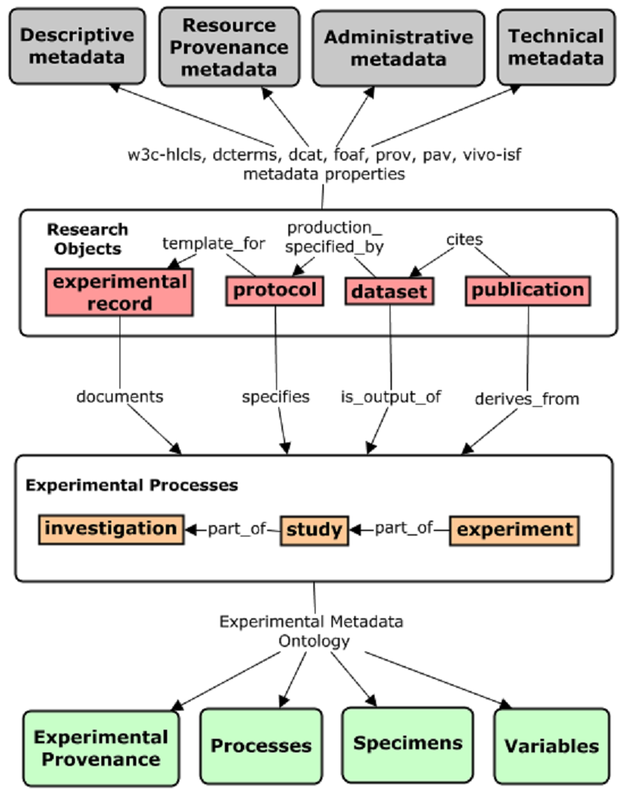
General Research
Object Metadata
Directly describes research objects
Two Components of a Research Object
Metadata Model
Experimental
Metadata
Describes experiments related to research objects

Slide 93
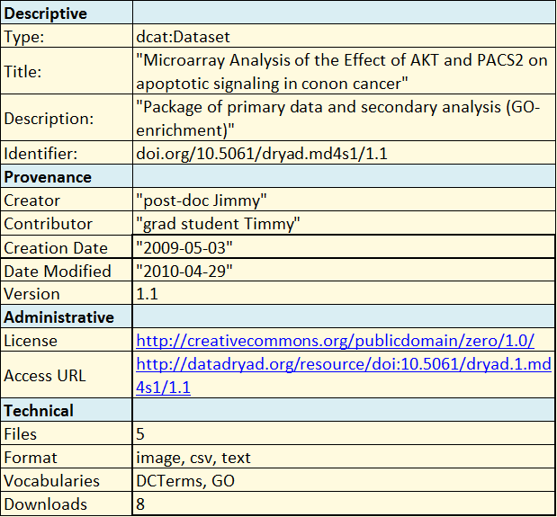
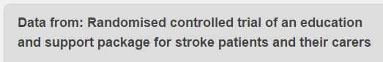
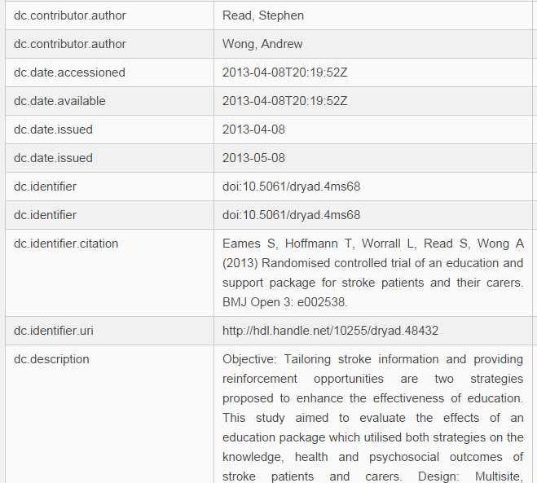
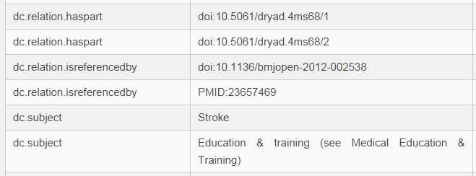
General Metadata Models
Describe general features of the research object
descriptive
provenance
technical
administrative
Typically flat, simple, majority of elements are domain neutral.
Many existing standards to use and specification to follow
Our task is to decide what attributes to describe, what existing standards to re-use, & where new modeling is needed (link)

Slide 94
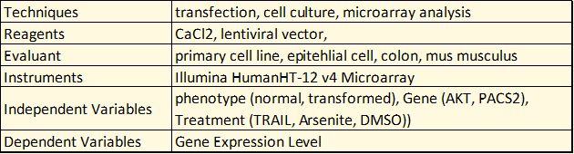
Experimental Metadata Models
Scope: Describe biological and experimental aspects of experiments related to research objects (e.g. how a dataset is generated and what it is about)
Challenges
experiments are complicated, relationships complex, the model is not flat.
incredible diversity of experimental practice and terminology across disciplines
few candidate standards, scoped for different use cases (ISA, EBI, KEfED)

Slide 95
Lessons Learned: Systems
Boutique/Domain-Specific Data Repositories
EBI ArrayExpress, NIH GEO
Data Journals
Nature Scientific Data, DataOne, Biodiversity Data Journal
Notes:
Initial focus was on large scale generic data repositories, given Elsevier use cases around developing a similar repository and data search tools across such systems
. . . primarily leverage Dublin Core directly or through mappings
-------------
Focus on systems cataloging and describing datasets submitted by researchers (as opposed to curated databases that aggregated data around specific entities, e.g. MGI,

Slide 96
Microarray Datasets
Methods
Experimental
Variables
Specimen
Characteristics
http://www.ebi.ac.uk/arrayexpress/experiments/E-MTAB-3315/
Notes:
Data type specific repositories do better, but not great . . .
Here is an example of what this type of metadata looks like in a microarray dataset repository called Array Express
(review metadata)
slightly better in that it captures . . . , so it can support some experimental queries such as . . .
but does not formally capture context needed to answer more precise queries such as
--
“Developed in relative isolation, many of them are created on dedicated technology platforms not optimized for integration with external search and
indexing services.”
Again, these boutique repositories that focus on specific types of experimental data are able to capture such details because of how constrained their scope is
The challenge remains is developing a generalizable framework for capturing experimental metadata across disciplines and datatypes
-----------------------------
these repos can often capture more specific and granular metadata because of the uniformity of the data they hold.
This repo focuses less on the generic metadata about the dataset such as . . . (which we saw captured in the dryad example), and more on metadata about the experiment that produced the data, such as . . .
This is useful for understanding how the experiment that produced the data was performed
and also useful for discovery of these datasets based on experimental attributes such as . . . . We will come back to this idea later when we dive deeper into metadata for research artifacts.

Slide 97
Defining Deliverables
Landscape Analysis
Structured evaluation of Initiatives, standards, and systems
Generic Metadata Recommendations
Identify core elements and propose standards to adopt
Reference Domain Model of Core Experimental Concepts
Concept Glossary
Taxonomic hierarchy
Ontology graph
Metadata schema
Experimental Metadata Model Straw Man
graph of exemplar experimental metadata record (concept map)
hierarchical metadata record of exemplar experimental metadata (pseudo-json)
Notes:
So with our landscape analysis we learned many important lessons and were in a position to define specific deliverables that would support our overarching goal for this project of defining a unified metadata model for describing research objects.
We learned that a diverse and informative body of work already exists in this area and can be leveraged in our work.
Deliverable 1 is a structured review of this landscape.
We learned that there is a pretty strong foundation of standards and practices around generic metadata collection
Deliverable 2 is a set of recommendations identifying core elements and standards to adopt here
We learned that the real challenge lies in defining standards around experimental concepts that are scoped and packaged for capturing real metadata about research object in curation systems.
Deliverable 3 is a simple Reference model that describes and relates core concepts in the domain
Deliverable 4 leverages this reference model to define a experimental metadata model straw man
Identify core elements and propose standards to adopt (link) (not focus of today so wont show)

Slide 98
Reference Model of Experimental Concepts
Identified ~20 concepts deemed most relevant for an experimental metadata model that is intuitive, generic, extensible, parsimonious, aligned with existing frameworks, and scoped for data entry and discovery
Glossary of Core Concepts
Presents preferred and alternate labels, definition, and significance with respect to modeling and metadata considerations (link)
List terms? . . .then separate slide for the text below, then go to google doc.
highlight importance of ‘ontological definitions’
Models of Core Concepts
A taxonomic hierarchy (link) that organizes these concepts to each other according their ontological type (material, process, attribute, information)
An ontology graph illustrating relationships between core concepts (link)
A hierarchical metadata schema (link) that organizes these concepts for the purpose of collecting and structuring metadata
Notes:
------------------
Start by just defining some core concepts - so I actually like this as a place to start distilling the large amount of information we have waded through and knowledge we have gained. What I have done is identified ~20 most important concepts relevant for an experimental metadata model that addresses our use cases and requirements.
I documented these in a google doc for now in the form of a glossary that . . .
And also two hierarchical artifacts: an ontological subsumption hierarchy that . . . and a hierarchical metadata schema
------------
Later this schema is translated into an ontological model (or at least a cmap specification of what one would look like)

Slide 99
Deliverables
Generic Metadata Recommendations
spreadsheet of core elements and proposed standards to adopt (link) (not focus of today so wont show)
Reference Domain Model of Core Experimental Concepts (presented as)
Concept Glossary
Taxonomic hierarchy
Ontology graph
Metadata schema
Experimental Metadata Model Straw Man
graph of exemplar experimental metadata record (concept map)
hierarchical metadata record of exemplar experimental metadata (pseudo-json)
Notes:
based on these lessons/needs, defined following goals for deliverables
LIST PURPOSES OF EACH INSTEAD OF COMPOENNTS – SHOW COMPONESNT WHEN WE GET TO THAT SLIDE
guide early iterations of internal metadata schema and community integration for new systems (e.g. data repo, integrated search tool). point to standards to adopt or align with
2. We need to take a step back and agree on the meeting at relationships between key concepts underlying experimental research, and use this as a basis for a shared understanding, clear and efficient discourse in communication, and a starting point and guiding set of principles for any integration efforts.
Reference domain model - align understanding of the domain and terminology used to describe it
Experimental Metadata Model: new model, informed by existing work but targeted specifically for our use cases

Slide 100
I Generic Metadata Recommendations
spreadsheet of core elements and proposed standards to adopt (link) (not focus of today so wont show)
informed largely by HCLS effort our group was involved in with same charge – led by Michel Dumontier who is now at Stanford / CEDAR group
goal is to guide early iterations of internal metadata schema and community integration for new systems (e.g. data repo, integrated search tool)
point to standards to adopt or align with
Notes:
DCAT and PROV other key considerations
decide what attributes to describe, what existing standards to re-use, & where new modeling is needed (link

Slide 101
III Experimental Metadata Model
Metadata Schema
Organizes core domain concepts as a hierarchical schema to support efficient metadata creation and search
Exemplar Metadata Records
Illustrates features of the metadata model using real data

Slide 102
Priority Use Cases
Metadata collection and publication: streamlined and intuitive collection of structured metadata and dissemination in computable form through web services LOD (XML, JSON, RDF)
Search/Discovery: support for finding research objects based on experimental attributes
Integration: model can be aligned with existing metadata schema
Comprehension/Interpretation (support for understanding the design and execution of an experiment . . . capture complete experimental design enough details of experiment to evaluate and interpret results)
Reproducibility . . . at a level that enables re-use of data/protocols or reproduction of results
‘Claims Analysis’ (metadata traces dependencies between samples, assays, variables, and outcomes to support interpretation of claims and evidence supporting them
Notes:
Wide range of possible use cases for describing datasets . . . schema are defined and optimized differently depending on the use case and project or system requirements. Aim is for minimal complexity to meet use case
Listed here are some different types of use cases for experimental metadata – can be optimized for ease of collection and sharing (require relatively concise and light-weight model)
For search and discovery – depends on CQs of users and how they wish to discover data
For Reproducibility . . .
For claims analysis . . .
Not an exhaustive list, but runs gamut from very simple requirements to much more complex and granular ones
For integration with external efforts
Metadata models can be scoped to meet a wide range of use cases – first step was to define ours
inform modeling requirements, and inform/parameterize/ provide criteria for our evaluation of landscape

Slide 103
Competency Questions
"Find datasets linked to publications from the Lin Lab"
"Find gene expression datasets produced using RNAseq technologies"
“Find imaging datasets from pathogen-exposed mice "
"Find datasets produced using Fugene reagent in cells derived from human colon"
"Find datasets investigating stroke in elderly smokers”
"Find datasets exploring effect of kinase knockdown on surface antigen expression in transformed vs normal primary cell lines”
Notes:
For search and discovery use case, critical to collect rich set of CQs to understand user needs and inform scope and design of the model
Note strong preference for discovery based on experimental attributes, as we expected
Took two approaches to defining requirements for our model
bottom up approach driven by competency questions. these are . . .

Slide 104
. . . But They Still Have Much to Offer
II. Emphasize the specification of experimental variables
A universal paradigm that describes how entities participate in an experiment
Captures the aspects most important for researchers to discover, understand, and analyze it on their terms
This perspective is necessary to answer queries about cause and effect
Find datasets that measure the effect of chemical stress on hippocampal action potential activity
Notes:
Another feature we adopted was the emphasis on
A universal paradigm that describes how entities participate in an experiment
Captures the aspects most important for researchers to discover, understand, and analyze it on their terms
This perspective is necessary to answer queries about cause and effect (what factors were applied to test an outcome of interest)

Slide 105
Modeling an Exemplar Experiment
Hypothesis: AKT-dependent stress response pathways activate distinct pathways in transformed adenocarcinoma cells vs healthy epithelial cells
Specimen Collection #1: collection of normal and transformed colon cells of an Apc<Min/+>[B6] mouse model of colon cancer
Specimen Collection #2: isolated cells used to establish cell culture
Treatment: chemical treatment of cultured cells with DMSO (control) or arsenite (oxidative stressor)
Specimen Collection #3: isolation of mRNA using TRIzol reagent to obtain mRNA samples
Assay: expression microarray analysis performed using an Illumina HumanHT-12 v4 array to identify patterns in level of gene expression
Techniques Specimens Controlled Variables
Independent Variables Dependent Variables
Notes:
So to illustrate the utility and features of this model, it helps to use an example of a real experiment.
This one is relatively simple – meant to illustrate core features of the model.
Hypothesis addressed here is . . .
Highlighted are the terms referencing instances of some of the core elements in our metadata model (namely techniques, specimens, . . . ). These represent important keywords users will query on to find datasets/ROs . . . so a key goal of our model is to capture this in as concise and standardized a way as possible.
------------------
structured – captured as discrete elements.
coded – values come from CVs
semantic – elements and values come from an underlying, logically encoded knowledge model that computers can reason with to add value to the data
--------
note that earlier slide deck had more complex running example that illustrates broader features of the model
put all this in a gdoc (the more complex earlier model, and the simpler model here, and link t it from this slide?)

Slide 106
Exemplar Experiment
Hypothesis: Activation of AKT-dependent stress response pathways in transformed vs healthy epithelial cells becomes less robust with age
Subject Selection: cohort identification of human males with colon cancer from rural communities, grouped by age (<50, >50).
Specimen Collection #1: cell collection from colon biopsies to isolate healthy and transformed epithelial cells, used to establish a cell culture (primary cell culture)
Treatment #1: siRNA transfection of cultured cells using CaCl2 to target AKT or an scr control
Treatment #2: chemical treatment of cultured cells with DMSO or arsenite at elevated temperatures (42C)
Specimen Collection #2: isolation of mRNA to obtain mRNA samples from treated cell cultures
Assay: expression microarray analysis performed using an Illumina HumanHT-12 v4 array to identify patterns in level of gene expression
Notes:
Find the most efficient way to capture these hooks and the critical relationships between them (context) to support discovery use cases?
Don’t need to describe each sample, or the workflow of the study – just the key parameters of the experiment that researchers care about when looking for and evaluating/interpreting data
But ideally model would be extensible / interoperable with a more granular/detailed model that does describe these things (for other use cases)

Slide 107
Exemplar Experiment
Techniques Specimens Controlled Variables
Independent Variables Dependent Variables
Subject Selection: cohort identification of human males with colon cancer from rural communities, grouped by age (<50, >50).
Specimen Collection #1: cell collection from colon biopsies to isolate healthy and transformed epithelial cells, used to establish a cell culture (primary cell culture)
Treatment #1: siRNA transfection of cultured cells using CaCl2 to target AKT or an scr control
Treatment #2: chemical treatment of cultured cells with DMSO or arsenite at elevated temperatures (42C)
Specimen Collection #2: isolation of mRNA to obtain mRNA samples from treated cell cultures
Assay: expression microarray analysis performed using an Illumina HumanHT-12 v4 array to identify patterns in level of gene expression
Notes:
Find the most efficient way to capture these hooks and the critical relationships between them (context) to support discovery use cases?
Don’t need to describe each sample, or the workflow of the study – just the key parameters of the experiment that researchers care about when looking for and evaluating/interpreting data
But ideally model would be extensible / interoperable with a more granular/detailed model that does describe these things (for other use cases)

Slide 108
Exemplar Experiment
Processes
cohort identification
cell collection
establish a cell culture
siRNA transfection
chemical treatment
isolation of mRNA
expression microarray analysis
Specimens
human (male, rural)
colon
epithelial cells
primary cell culture
mRNA
Controlled Variables
Reagent (CaCl2)
Instrument (Illumina HumanHT-12 array)
Specimen (human, male rural, colon cancer)
Independent Variables
age (<50, >50)
phenotype (healthy , transformed)
gene (AKT, scr)
chemical treatment (DMSO, arsenite)
Dependent Variables
level of gene expression
All of these terms represent potential ‘hooks’ into the data, and contextualizing their participation in an experiment will support precise queries and analyses
Notes:
Find the most efficient way to capture these hooks and the critical relationships between them (context) to support discovery use cases?
Don’t need to describe each sample, or the workflow of the study – just the key parameters of the experiment that researchers care about when looking for and evaluating/interpreting data
But ideally model would be extensible / interoperable with a more granular/detailed model that does describe these things (for other use cases)

Slide 109
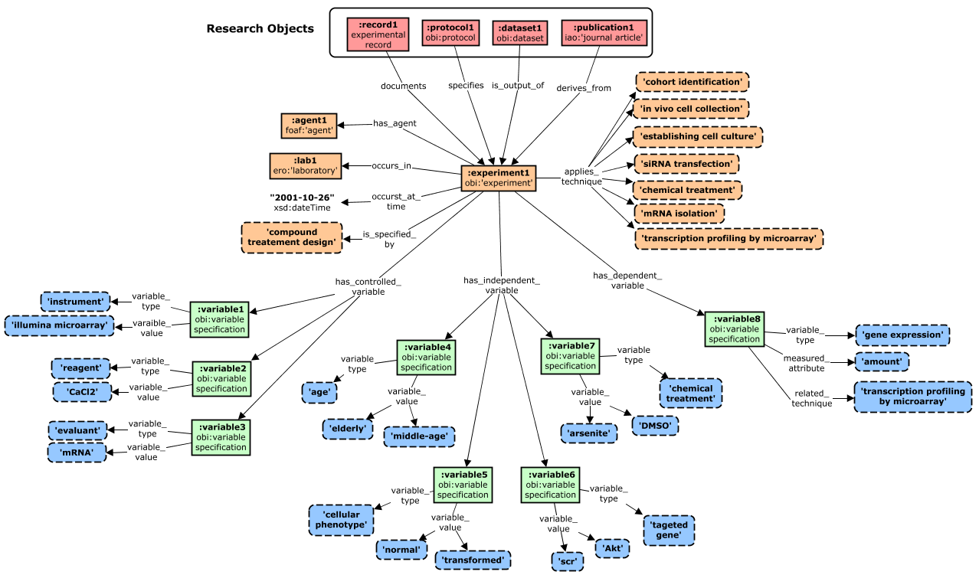
Core Metadata Model
The core model captures minimal essential experimental metadata for core CQs and modeling requirements, and is organized around ‘variable specification’ nodes (green)

Slide 110
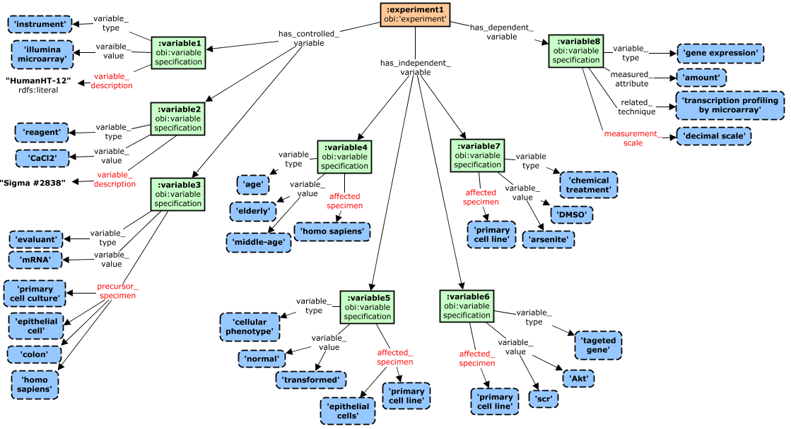
Extending Variable Descriptions
The core model can be extended to better contextualize variables in the experimental workflow (here by supporting a richer description of specimens and how they relate to variables)

Slide 111
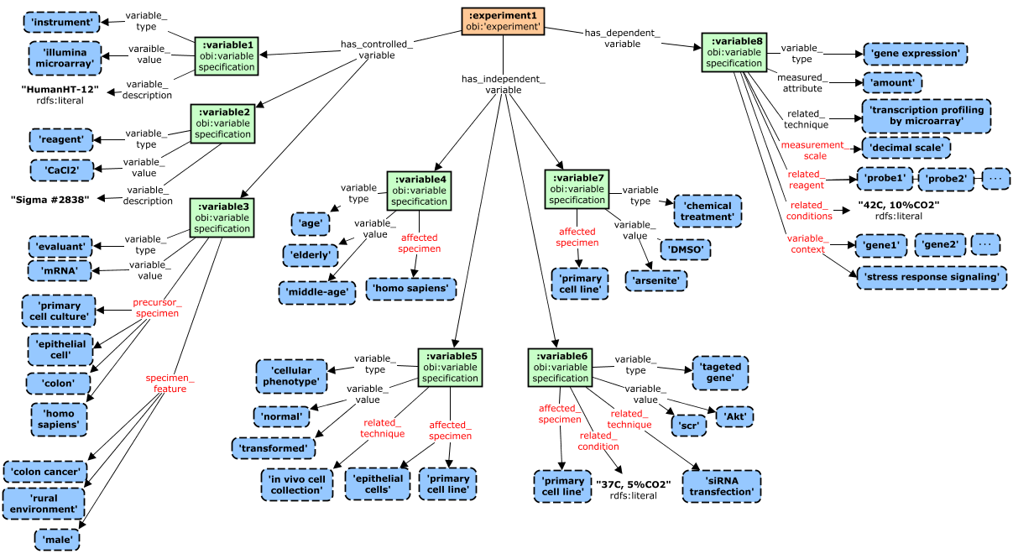
Extending Variable Descriptions
Additional properties can support additional contextualization of variables by describing techniques used to apply or measure them, or related experimental conditions)

Slide 112
Driving Principles and Requirements
Support for Discovery: minimal complexity to support all CQs
Pragmatic: Imparts minimal curation burden
Interoperable: Align with and re-use from existing efforts where possible (in design patterns and CVs as value constraints)
Use community CVs/ontologies to standardize data entry
Support integration of data across existing repositories
Universal /Generic but Extensible: accommodate diverse research disciplines while supporting extensions for specific domains and use cases
Flat: Minimal number of ‘levels’ in the model flat models simpler to understand, enter data, compose searchers . . . but complexity supports ability to answer more precise queries – find right balance
Context: captures roles and relationships between specimens, techniques, and variables
Important to be explicit about the role different entities play in the experiment in concise a way as possible (not only capture what participates in an experiment, as many repos do with keywords, but the how)
Notes:
A universal paradigm that describes how entities participate in an experiment
Captures the aspects most important for researchers to discover, understand, and analyze it on their terms
This perspective is necessary to answer queries about cause and effect (what factors were applied to test an outcome of interest)
Evaluation of CQs and existing models all pointed to a central importance of describing these three aspects of experiments and the relationship between them, which is something we took to heart in defining our initial model

Slide 113
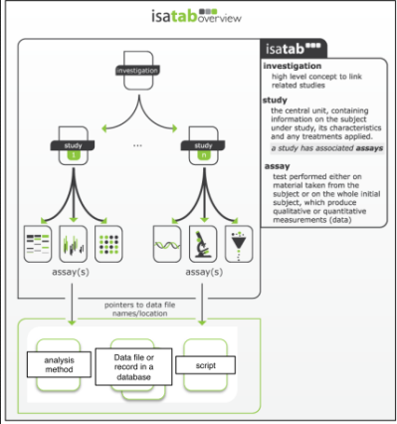

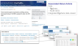
Systems
3. Data Journals
Nature Scientific Data
DataOne
Biodiversity Data Journal
Susanna Assunta Sansone, http://www.slideshare.net/SusannaSansone/fair-data-and-npg-scientific-data-riken-yokohama-25-june-2014/23
Notes:
NSD: a peer reviewed publication for ‘Data Descriptors. Rigorously describe and contextualize a high-value and high-quality data sets. But not a repository - recommend actual data stored in open community repositories (generic such as dryad or figshare, or boutique such as GEO).
Narrative descriptor accompanied by a structured metadata package that uses the ISA model. Comprehensive metadata, including rich experimental metadata, to support re-use and reproducibility use cases. Nice place to use ISA model because authors willing to put in the work for a publication - but this level of curation impractical for other systems to implement.
-------------
where there is impetus an incentive to spend the time creating very detailed and rigorous metadata. Because here they use cases to support interpretation and reproducibility, not simply data discovery. But this isn't the case for most other data sets and repositories, and that the case for our efforts which are focused on the discovery.
Mention that they use the ISA model to provide a structured metadata set in addition to the data descriptor narrative. Captures rich and granular metadata for purpose of interpretation and reproducibility
not a repository – recommend actual data stored in open community repositories (generic such as dryad or figshare, or boutique such as GEO)
higher standard as these are publications – Nature Scientific Data
More rigorous and comprehensive metadata collected, including experimental metadata
Nature adopted leading community standard for describing biomedical research data – ISA

Slide 114
Standards
1. Generic Metadata
Title, Contributors, Identifiers, Creation/Modification Dates, Version, Access Info, File size, File Format, Keywords
Directly describes datasets
Many mature and widely used standards exist, reasonably aligned
Two Levels of
Metadata Standards
for Research Objects
2. Experimental Metadata
Indirectly describes datasets by capturing experimental provenance
Existing standards not scoped or packaged for efficient metadata collection and discovery
Notes:
Looked at nearly 50 schema, formats, and ontologies - diversity and complexity was overwhelming
Key take home from review of existing standards is that there are two levels of metadata standards for research objects . . .
prominent examples of standards for each shown in here . . .
Generic Standards - many competing metadata standards here, but aligned reasonable well (main difference was being scoped for different use cases).
Mature, broadly used across existing data and information systems.
HCLS - Even efforts to merge and define ‘best of breed’ standard that unifies elements from 20 different standards into a coherent and comprehensive model for describing datasets.
Picture was less rosy when it came to standards that could be used to describe experimental provenance of datasets
While many models of experimental research exist, . . . none are scoped and packaged to support metadata collection . . .
OBI, ISA, KEfED, SIO, EFO, OBX, VIVO-ISF
While many models of experimental research exist, . . . none are scoped and packaged to support metadata collection . . .
Lack of unifying high-level conceptual model of experimental concepts to serve as a foundation for alignment and interoperability
Will explore a few of these that in a little more detail shortly

Slide 115
Exemplar Metadata Record (~json)
{
dataset_uri: "http://datadryad.org/resource/doi:xx.yyy/dryad.zzzz"
{
experiment:
investigator: investigator1
laboratory: lab1
time: "2001-10-26"
study design: compound treatment design
technique: chemical treatment
technique: water maze test
technique: mRNA isolation
technique: transcriptional profiling by microarray
controlled _variable: [
{variable_type: instrument
variable_value: Illumina HT-12v4 microarray
resource_description: "lot #2314, 2001-02-15"}
{variable_type: reagent
variable_value: TRIzol
resource_identifier: "Ambion 15596"}
{variable_type: evaluated specimen
variable_value: mRNA}
{variable_type: precursor specimen
variable_value: astrocyte}
{variable_type: precursor specimen
variable_value: mus musculus
resource_description: "RRID:MGI_5446893"}
]
independent_variable: [
{variable_type: phenotype
precursor_specimen: colon
variable_value: normal
variable_value: memory-impaired
affected_specimen: mus musculus
related_technique: water maze test}
{variable_type: chemical exposure
variable_value: DMSO
variable_value: arsenite
affected_specimen: mus musculus
related_conditiion: “37C, 5%CO2"}
]
dependent variable: [
{variable_type: gene expression
measured_attribute: amount
related_technique: transcriptional profiling by microarray
has_scale: decimal}
]
}
}
{
dataset_uri: "http://datadryad.org/resource/doi:10.5061/dryad.1127"
{
experiment:
agent: agent1
laboratory: lab1
time: "2001-10-26"
design: compound treatment design
technique: cohort identification
technique: in vivo cell collection
technique: establishing cell culture
technique: siRNA transfection
technique: chemical treatment
technique: mRNA isolation
technique: transcriptional profiling by microarray
controlled _variable: [
{variable_type: instrument
variable_value: Illumina microarray
variable_description: "HumanHT-12"}
{variable_type: reagent
variable_value: CaCl2
variable_description: "Sigma#2838"}
{variable_type: evaluant
variable_value: mRNA
precursor_specimen: primary cell culture
precursor_specimen: epithelial cell
precursor_specimen: colon
precursor_specimen: homo sapiens
specimen_feature: colon cancer
specimen_feature: rural environment
specimen_feature: male}
]
dependent variable: [
{variable_type: gene expression
measured_attribute: amount
related_technique: transcriptional profiling by microarray
measurement_scale: decimal
related_reagent [ probe1, probe2, probe 3, . . . ]
realted_conditiions: "42C, 5%CO2"}
]
Json representation of full metadata record for exemplar experiment
Relatively simple and flat, while capturing needed precision and variable context for core CQs and modeling requirements
independent_variable: [
{variable_type: age
variable_value: elderly
variable_value: middle-age
affected_specimen: homo sapiens}
{variable_type: cellular phenotype
variable_value: normal
variable_value: transformed
affected_specimen: epithelial cell
affected_specimen: primary cell line
related_technique: in vivo cell collection}
{variable_type: chemical treatment
variable_value: DMSO
variable_value: arsenite
affected_specimen: primary cell line}
{variable_type: targeted gene
variable_value: AKT
variable_value: scr
affected_specimen: primary cell line
related_technique: siRNA transfection
related_condition: "37C, 5%CO2"}
]
}
}

Slide 116
2 Competency Questions
"Find datasets linked to publications from the Lin Lab"
"Find gene expression datasets produced using RNAseq technologies"
“Find imaging datasets from pathogen-exposed mice "
"Find datasets produced using Fugene reagent in cells derived from human colon"
"Find datasets investigating stroke in elderly smokers”
"Find datasets exploring effect of kinase knockdown on antigen expression in transformed vs normal primary cell lines”
Notes:
For search and discovery use case, critical to collect rich set of CQs to understand user needs and inform scope and design of the model
CQs help to specify the kinds of entities to represent and the relationships needed between them to efficiently answer simple and complex queries.
Helps to highlight domain concepts traversed by each query (and relationships between them – not shown here)
Noted strong preference for discovery based on experimental attributes, as we expected
-------------------
Took two approaches to defining requirements for our model
bottom up approach driven by competency questions. these are . . .

Slide 117
III. Project Deliverables
D1. Landscape Analysis (link)
Structured evaluation of initiatives, standards, and systems
D2. Generic Metadata Recommendations (link)
Identify core elements and propose standards to adopt
D3. Reference Model of Experimental Concepts (link)
Concept glossary and models
D4. Experimental Metadata Model Straw Man (link)
Model and exemplar metadata records
Notes:
So with our landscape analysis we learned many important lessons and were in a position to define specific deliverables that would support our work toward defining a unified metadata model for describing research objects.
We learned that a diverse and informative body of work already exists in this area and can be leveraged in our work.
Deliverable 1 is a structured review of this landscape.
We learned that there is a pretty strong foundation of standards and practices around generic metadata collection
Deliverable 2 is simply a set of recommendations identifying core elements and standards to adopt here
We learned that the real challenge lies in defining standards around experimental metadata that can support its collection and integration. And that a shared conceptual framework is needed to support this goal.
Toward this end, Deliverable 3 is a simple Reference model that defines and relates core concepts in the domain that are important for this purpose
Deliverable 4 leverages this reference model to define a experimental metadata model and schema for data collection
For the rest of my time today I want to give a tour of these deliverables and outcomes.

Slide 118
D3. Reference Model of Core Experimental Concepts
D4. Experimental Metadata Model
Foundations for communication, model development, data collection and integration, defining community standards
Requirements Analysis
Scoped by identifying priority use cases
Driven be competency questions (link)
Informed by evaluation of existing models
Notes:
Our third and fourth deliverables go hand in hand – the goal being to provide a foundation for understand, communication, modeling, and data integration and standard development
This work required some significant requirements analysis at three levels:
We identified ~20 concepts deemed most relevant for an experimental metadata model that is intuitive, generic, extensible, parsimonious, aligned with existing frameworks, and scoped for data entry and discovery
Goal is to agree on the meeting at relationships between key concepts underlying experimental research, and use this as a basis for a shared understanding, clear and efficient discourse in communication, and a starting point and guiding set of principles for any integration efforts.
Need highlighted by observation that existing standards lack a shared foundation for discourse and interoperability – that identifies key concepts, rigorously defines and distinguishes them, and defines relationships that hold between them in context of a scientific experiment.
Now this is exactly the goal of domain reference ontology's such as OBi and Sio. And these models certainly informed our work. But to be practically useful a more focused set of concepts that are defined in the context of a specific use case, such as data said discovery and integration, is ultimately what will be useful in practice. And what can inform schema for collecting experimental metadata for these purposes.
what we aimed for was really a version of OBI scoped for a specific use cases (experimental metadata for discovery of research objects)
------------------
Start by just defining some core concepts - so I actually like this as a place to start distilling the large amount of information we have waded through and knowledge we have gained. What I have done is identified ~20 most important concepts relevant for an experimental metadata model that addresses our use cases and requirements.
I documented these in a google doc for now in the form of a glossary that . . .
And also two hierarchical artifacts: an ontological subsumption hierarchy that . . . and a hierarchical metadata schema
------------
Later this schema is translated into an ontological model (or at least a cmap specification of what one would look like)

Slide 119
Experimental Models
D3. Reference Model of Core Experimental Concepts
D4. Experimental Metadata Model
Foundations for communication, model development, data collection and integration, defining community standards
Requirements Analysis
Scoped by identifying priority use cases
Driven be competency questions (link)
Informed by evaluation of existing models
Notes:
Our third and fourth deliverables go hand in hand – the goal being to provide a foundation for understand, communication, modeling, and data integration and standard development
This work required some significant requirements analysis at three levels:
We identified ~20 concepts deemed most relevant for an experimental metadata model that is intuitive, generic, extensible, parsimonious, aligned with existing frameworks, and scoped for data entry and discovery
Goal is to agree on the meeting at relationships between key concepts underlying experimental research, and use this as a basis for a shared understanding, clear and efficient discourse in communication, and a starting point and guiding set of principles for any integration efforts.
Need highlighted by observation that existing standards lack a shared foundation for discourse and interoperability – that identifies key concepts, rigorously defines and distinguishes them, and defines relationships that hold between them in context of a scientific experiment.
Now this is exactly the goal of domain reference ontology's such as OBi and Sio. And these models certainly informed our work. But to be practically useful a more focused set of concepts that are defined in the context of a specific use case, such as data said discovery and integration, is ultimately what will be useful in practice. And what can inform schema for collecting experimental metadata for these purposes.
what we aimed for was really a version of OBI scoped for a specific use cases (experimental metadata for discovery of research objects)
------------------
Start by just defining some core concepts - so I actually like this as a place to start distilling the large amount of information we have waded through and knowledge we have gained. What I have done is identified ~20 most important concepts relevant for an experimental metadata model that addresses our use cases and requirements.
I documented these in a google doc for now in the form of a glossary that . . .
And also two hierarchical artifacts: an ontological subsumption hierarchy that . . . and a hierarchical metadata schema
------------
Later this schema is translated into an ontological model (or at least a cmap specification of what one would look like)

Slide 120
1 Priority Use Cases
Search/Discovery: meet minimal criteria for discovery based on experimental attributes and relationships
Data Entry: Intuitive and efficient collection of structured metadata with minimal curation burden needed for other use cases
Interoperability: can be aligned with existing metadata schema
Claims Analysis: structured to trace dependencies between samples, assays, variables, and outcomes , to support evaluation of claims and evidence supporting them
Reproducibility: captures sufficient detail about experimental participants and execution to support reproduction of results
Notes:
Wide range of possible use cases for describing datasets . . . schema are defined and optimized differently depending on the use case and project or system requirements. Aim is for minimal complexity to meet use case
Listed here are some different types of use cases for experimental metadata – can be optimized for ease of collection and sharing (require relatively concise and light-weight model)
For search and discovery – depends on CQs of users and how they wish to discover data
For interoperability
For Reproducibility . . .
For claims analysis . . .
Not an exhaustive list, but runs gamut from very simple requirements to much more complex and granular ones
------------------
Comprehension/Interpretation (support for understanding the design and execution of an experiment . . . capture complete experimental design enough details of experiment to evaluate and interpret results)
For integration with external efforts
Metadata models can be scoped to meet a wide range of use cases – first step was to define ours
inform modeling requirements, and inform/parameterize/ provide criteria for our evaluation of landscape

Slide 121
. . . But They Still Have Much to Offer
Converge on central relationship between techniques, specimens, and variables
Variables: entities intentionally varied or measured
Dependent variable: specifies entity and attribute measured in an assay
Independent variables: specifies parameters intentionally varied to test affect on dependent variable
Controlled variables: parameters not varied across groups
reagents, instruments applied to all study groups
characteristics of specimens intentionally held constant
Find datasets that measure the effect of X on Y using Z
(e.g. temperature on action potential activity using patch clamping)
Notes:
dep var (measured variable): specifies entity and attribute measured in an assay (e.g. level of gene expression)
Independent var (factors, parameters) - specifies parameters intentionally varied to test affect on dependent variable (e.g. exposure to agents like chemicals, or inherent characteristics of the specimen such as having transformed vs normal phenotype)
Controlled variables - parameters not varied across study groups
reagents, instruments applied to all study groups consistently
------------
A universal paradigm that describes how entities participate in an experiment
This perspective is necessary to answer queries about cause and effect (what factors were applied to test an outcome of interest)
Evaluation of CQs and existing models all pointed to a central importance of describing these three aspects of experiments and the relationship between them, which is something we took to heart in defining our initial model
this is one feature we adopted to inform our modeling

Slide 122
. . . But They Still Have Much to Offer
Converge on central relationship between techniques, specimens, and variables
Variables: entities intentionally varied or measured
Dependent variable: specifies entity and attribute measured in an assay
Independent variables: specifies parameters intentionally varied to test affect on dependent variable
Controlled variables: parameters not varied across groups
reagents, instruments applied to all study groups
characteristics of specimens intentionally held constant
Find datasets that measure the effect of X on Y using Z
(e.g. temperature on action potential activity using patch clamping)
Notes:
dep var (measured variable): specifies entity and attribute measured in an assay (e.g. level of gene expression)
Independent var (factors, parameters) - specifies parameters intentionally varied to test affect on dependent variable (e.g. exposure to agents like chemicals, or inherent characteristics of the specimen such as having transformed vs normal phenotype)
Controlled variables - parameters not varied across study groups
reagents, instruments applied to all study groups consistently
------------
A universal paradigm that describes how entities participate in an experiment
This perspective is necessary to answer queries about cause and effect (what factors were applied to test an outcome of interest)
Evaluation of CQs and existing models all pointed to a central importance of describing these three aspects of experiments and the relationship between them, which is something we took to heart in defining our initial model
this is one feature we adopted to inform our modeling

Slide 123
D4. Experimental Metadata Model
D3. Reference Model of Core Experimental Concepts
Concept Glossary
Conceptual Domain Models
Metadata Model Proposals
Exemplar Metadata Records
Foundations for communication, metadata collection and integration, and building shared community standards
Notes:
Our third and fourth deliverables go hand in hand – a concept glossary and domain model of key research object concepts, and a more formal experimental metadata model based on these concepts
The common goal of these efforts is to provide a foundation for communication, data collection and integration, and building shared community standards.

Slide 124
Requirements Analysis
Scoped by identifying priority use cases
Driven be competency questions (link)
Informed by evaluation of existing models
Notes:
As with any modeling work we do, we began by performing requirements analysis on three levels.
The models would be scoped by identifying priority use cases
Their content and structure would be driven by CQs and informed by an evaluation of existing models

Slide 125
Priority Use Cases
Search/Discovery: meet minimal criteria for discovery based on experimental attributes and relationships
Data Entry: intuitive and efficient collection of structured metadata with minimal curation burden
Interoperability: enable alignment with existing metadata schema
Notes:
Wide range of possible use cases for describing datasets . . . models are defined and optimized differently depending on the use case and project or system requirements. Aim is for minimal complexity to meet use case
Listed here are the three use cases we prioritized for our work based on landscape analysis and feedback from Elsevier.
some different types of use cases for experimental metadata – can be optimized for ease of collection and sharing (require relatively concise and light-weight model)
For search and discovery – must meet the . . . This depends on CQs of users and how they wish to discover data.
For data entry, we need to support intuitive and
For interoperability, . . .
--------------
Claims Analysis: structured to trace dependencies between samples, assays, variables, and outcomes , to support evaluation of claims and evidence supporting them
Reproducibility: captures sufficient detail about experimental participants and execution to support reproduction of results
Not an exhaustive list, but runs gamut from very simple requirements to much more complex and granular ones

Slide 126
Competency Questions
"Find datasets linked to publications from the Lin Lab"
"Find gene expression datasets produced using RNAseq technologies"
“Find imaging datasets from pathogen-exposed mice "
"Find datasets produced using Fugene reagent in cells derived from human colon"
"Find datasets investigating stroke in elderly smokers”
"Find datasets exploring effect of kinase knockdown on antigen expression in transformed vs normal primary cell lines”
Notes:
For search and discovery use case, critical to collect rich set of CQs to understand user needs and inform scope and design of the model
CQs help to specify the kinds of entities to represent and the relationships needed between them to efficiently answer simple and complex queries.
Helps to highlight domain concepts traversed by each query (and relationships between them – not shown here)
Noted strong preference for discovery based on experimental attributes, as we expected
-------------------
Took two approaches to defining requirements for our model
bottom up approach driven by competency questions. these are . . .

Slide 127
Evaluation of Existing Standards
OBI (Ontology for Biomedical Investigations) Broad and rich, but focus in on biomedicine, and not suited or being used as a metadata model/schema (too complex, tied to realist view)
ISA (Investigation-Study-Assay) Schema A schema for metadata collection that is widely used, but model is too granular, under-constrained, and not scoped for our use case
KEfED (Knowledge Engineering from Experimental Design) A high-level schema with right level of abstraction/complexity, but lacks ontological underpinnings and integration, receives limited use, and structured for claims analysis use cases.
EBI (European Bioinformatics Institute) RDF Platform Supports data collection and scoped for discovery use case, narrowly defined for specific datatypes and domains
Existing models do not serve our needs ...
Notes:
Finally, examined handful of existing schema and models describing biomedical investiggations that seemed closest fit for our needs
OBI: Broad and rich, but focus in on biomedicine, and not suited or being used as a metadata model/schema (too complex, tied to realist view). Can inform our work but not directly applicable
ISA: A schema for metadata collection that is widely used, but model is too granular, under-constrained, and not scoped for our use case
KEfED Framework: A high-level schema with right level of abstraction/complexity, but lacks ontological underpinnings and integration, receives limited use, and structured for claims analysis use cases. Mor of a framework than a formal semantic schema
EBI: Supports data collection and scoped for discovery use case, narrowly defined for specific datatypes and domains (e.g. microarray in Array Express)
Isa and EBI – specimen centric model
KeFED and OBI – process centric models
Variable centric model most efficinet for metadata creation and search
- no have to create instances for each specimen/sample in a study, and describe each process applied to them
just present a summary level view of all TYPES of processes and reagents and specimens used, organized around the experimental variables that describe how they participated in the study
top down approach to defining requirements.
Upshot is existing models do not serve our needs . . . none support level of integration with existing ontologies to adequately constrain data entry

Slide 128
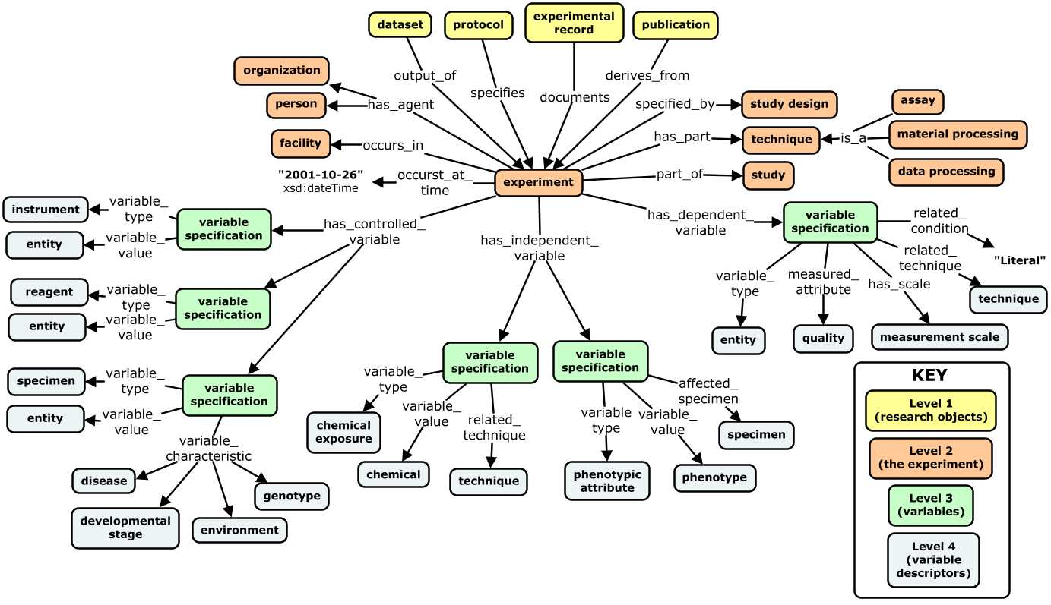
A Variable-Centric Experimental Metadata Model
Notes:
This is a concept map of our initial straw man proposal
View of a fairly informal initial straw man

Slide 129
A Variable-Centric Experimental Metadata Model
Notes:
This is a concept map of our initial straw man proposal
View of a fairly informal initial straw man

Slide 130
A Variable-Centric Experimental Metadata Model
Notes:
This is a concept map of our initial straw man proposal
View of a fairly informal initial straw man

Slide 131
Modeling an Exemplar Experiment
(GO)
(PATO)
(OBI)
Notes:
This concept map shows how our model represents metadata about this experiment.

Slide 132
Modeling an Exemplar Experiment
(PATO)
(ChEBI)
(NCBI Taxonomy)
(OBI)
Notes:
This concept map shows how our model represents metadata about this experiment.

Slide 133
Modeling an Exemplar Experiment
(OBI)
(ChEBI)
(ChEBI, RNAO)
(CL)
(NCBI
Taxonomy)
(DO)
Notes:
This concept map shows how our model represents metadata about this experiment.

Slide 134
A Variable-Centric Experimental Metadata Model
dataset
experiment (1 . . .m)
investigator (1 . . . m)
research organization (1 . . . m)
research facility (1 . . .m)
occurs at time (1 . . . 1)
technique (0 . . . m)
part of study (0...m)
study design (0...m)
control variable (reagent) (0 . . . m)
variable type (1. . .1)
variable value (1 . . . 1)
variable characteristic (0 . . .m)
resource description (0 . . . 1)
controlled variable (instrument) (0 . . . m)
variable type (1. . .1)
variable value (1 . . . 1)
variable characteristic (0 . . .m)
resource description (0 . . . 1)
controlled variable (evaluated specimen) (0 . . . m)
variable type (1. . .1)
variable value (1 . . . 1)
variable characteristic (0 . . .m)
resource description (0 . . . 1)
independent variable (1 . . .m)
variable type (1. . . 1)
variable value (1 . . . m)
affected specimen (0 . . .m)
related technique (0 . . .m)
related condition (0 . . . m)
dependent variable (1 . . .1)
variable type (1. . .1)
measured attribute (1 . . . 1)
related technique (0 . . .m)
has scale (0 . . . 1)
related condition (0 . . . m)
Notes:
For reference this is a view of same model as a hierarchical metadata schema (is in the google doc as well)

Slide 135
Modeling an Exemplar Experiment
Hypothesis: Differential stress-response pathways are activated in brains of normal vs memory-impaired mice.
Treatment: exposure of a mouse model of Alzheimer’s Disease to DMSO (control) or arsenite (oxidative stressor)
Specimen Collection #1: collection of astrocytes from hippocampi of mice displaying normal vs impaired memory (in water maze tests)
Specimen Collection #2: isolation of mRNA using TRIzol reagent to obtain mRNA samples
Assay: expression microarray analysis using an Illumina HT-12 array to identify patterns in level of gene expression
Controlled Variables Independent Variables Dependent Variables
Notes:
So the clearest way to demonstrate the model itself is to show how it captures metadata for a real experiment.
So here is our canned example. It is relatively simple and meant to illustrate core features and utility of the model.
This experiment explores the hypothesis that differential . . .
It begins with a chemical treatment: exposure of a mouse model . . .
Astrocytes are then collected from the hippocampi of mice displaying either normal or impaired memory function in a water maze test.
mRNA is then isolated from these astrocytes, and used as input in a microarray assay to test gene expression patterns.
I have highlighted concepts that represent control, independent, and dependent variables – because these concepts play a central role in our model. You may find requires a new way of looking at an experiment – to think first of the type of variable things represent rather than the experimental role they play as a reagent, specimen, or instrument, which is also captured but secondarily.
For example, astrocyte and hippocampus are control variables because these are features common to ALL study groups in the experiment.
DMSO and arsenite on the other hand are independent variables that help define separate study groups in the experiment. And of course the level of gene expression is the measured, dependent variable.
------------
Highlighted are the terms referencing instances of some of the core elements in our metadata model (namely techniques, specimens, . . . ). These represent important keywords users will query on to find datasets/ROs . . . so a key goal of our model is to capture this in as concise and standardized a way as possible.

Slide 136
IV. Applications and Future Directions
1. Partnering with the Community
Establish a FORCE11 Working Group
Inform Open Research Information Framework (OpenRIF) efforts
evolution of VIVO/eagle-i developer community
Work with BD2K Data Discovery Index Metadata WG (bioCADDIE)
DDI white paper (link)
bioCADDIE metadata specification v1 (link)
Notes:
So I want to quickly close by highlighting some potential applications and future directions for this work
In terms of how we might partner with the community, our next step is to establish a broader working group under the FORCE11 framework focused on these issues to promote, improve, and apply our work
We can also partner with the OpenRIF to inform their work. OpenRIF is the new name for working group we are leading that was historically associated with the VIVO-ISF standard – and we are beginning work to improve and expand modeling of attribution, provenance for research artifacts.
Finally, we also have contacts with with BD2K Data Discovery Index Metadata WG.
This is work that began after i completed the contract work presented here. Part of the larger NIH BD2K Initiative, which funded the bioCADDIE team at UCSD to build a data discovery index.
This is to be a system to index metadata about biomedical datasets across repositories using a common model, and a search interface to support discovery and sharing.
Metadata working group was tasked to define a model that could be used to aggregate metadata across existing data repositories under a unified framework (very similar to the goal of my work for Elsevier).
I have done an initial comparison of their model and my proposals, and can discuss details if there is interest and time - overall a very similar selection of core domain concepts but some critical differences in the way these are hooked together to define a metadata schema.
Our work has been shared with bioCADDIE DDI metadata team, and we are on their external advisory panel. But not significant interaction yet due to lack of bandwidth and resources on our part. Looking in new year for opportunity to work with them – maybe secure pilot project funding to evaluate and iterate on the model?
------------------
- I think it is actually pretty good. v1 is essentially a more formally specified and complex version of the ISA model (not surprising given it was created by same group)
- Very similar in scope and perspective as our straw man (albeit much more extensive and granular in its detail).
- Key issue for me is that the core notion of independent and dep variables are imprecisely defined, inconsistently captured, poorly constrained.
- Does not take a variable centric approach.
- Again, similar set of entities in the model, but distinctions between concepts and relationships between them in the bioCADDIE work led to a much richer and more complex model
- Goes into deeper detail and granularity than I think is needed for a purely discovery use cases, but I suspect they are starting as comprehensive as possible to best align with existing work, and can scale down for specific applications in the future.
- Approach was very similar as well:
top down (learn from existing standards, schema, and systems)
bottom up (CQ driven derivation of metadata elements)

